Slide 1
Weight management –the Lighten Up studies and further trials
Kate Jolly
Institute of Applied Health Research
University of Birmingham

Slide 2
Aims of this talk
To describe a suite of studies based on the Lighten Up service in Birmingham
  Lighten Up trial
  Non-inferiority analysis comparing range of weight management providers
  Effectiveness of a weight maintenance intervention
  Lighten-Up Plus trial
To describe ongoing and future trials

Slide 3
Background: Obesity
Approx 1 in 4 adults in the UK are obese (BMI ≥ 30 Kg/m²)
A further 38% are overweight (BMI 25+ to <30Kg/m²⁾
Obesity aetiological factor in coronary heart disease, diabetes, some cancers, musculoskeletal disorders....
Specialist hospital-based NHS services are unable to respond to this number of patients
NHS South Birmingham sought alternative options for community based services

Slide 4
The Lighten Up Service
Locally authority funded (formerly PCT)
Delivered by third sector organisation
Participants referred from primary care or can self-refer
Central service accessed by telephone and underpinned by web-database with details of clients and available services
Choice of providers

Slide 5
A randomised controlled trial to compare a range of commercial or primary care led weight reduction programmes with a minimal intervention control for weight loss in obesity: the Lighten Up Trial
Jolly K, Lewis A, Beach J, Denley J, Adab P, Daley A, Aveyard P. A randomised controlled trial to compare a range of commercial or primary care led weight reduction programmes with a minimal intervention control for weight loss in obesity: the Lighten Up trial. BMJ 2011;343:d6500.

Slide 6
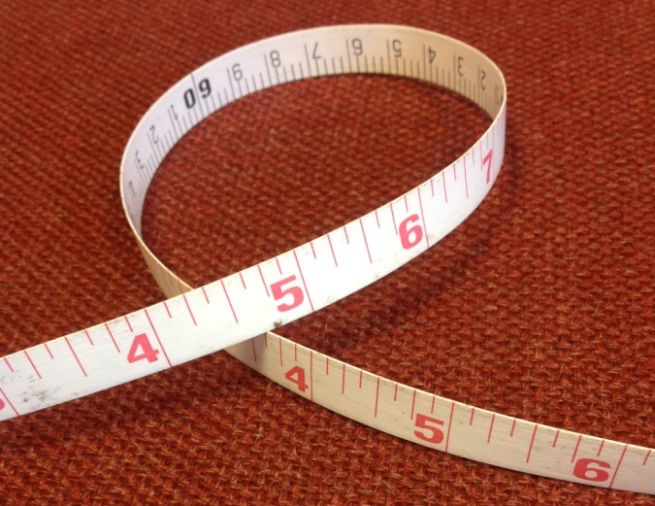
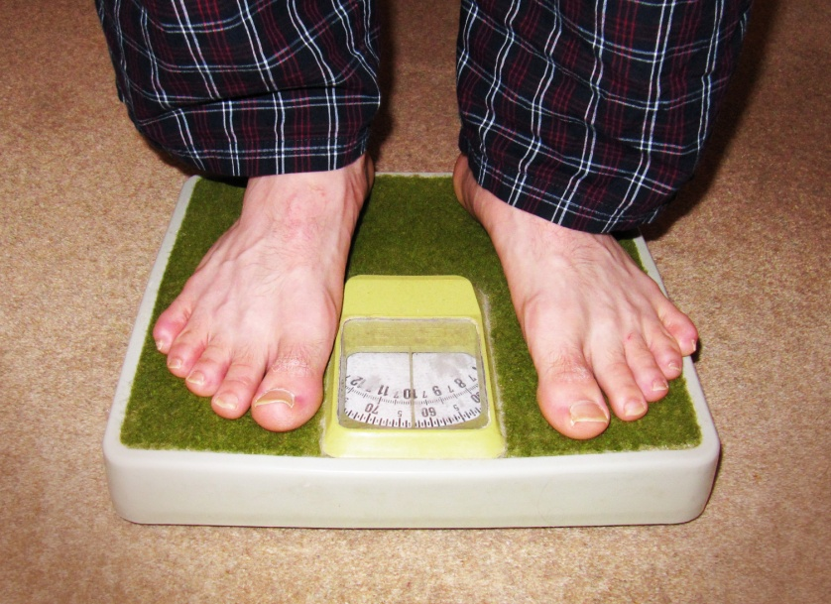
Research question
How do weight loss programmes compare to a minimal intervention comparator in terms of weight change at 3 and 12 months?

Slide 7

Methods: Design
Weight Watchers: n=100
Slimming World: n=100
RCT
Rosemary Conley: n=100
NHS group-based programme: n=100
General practice (one-to-one): n=70
Pharmacy (one-to-one): n=70
Choice n=100
Minimal intervention comparator (12 leisure centre vouchers): n=100

Slide 8
Methods: Inclusion & Exclusions
Inclusion criteria
Aged 18+
BMI ≥30 (recorded via QOF last 15 months) or >25 if South Asian (>28 and >23 respectively with co morbidities)
Identified by GP as medically competent to enter evaluation
Service exclusions:
  Unable to understand English
  Women who are known to be pregnant
  Currently attending a weight loss programme
Trial exclusions
  Not willing to be randomised
  unable take part in exercise element
  Waiting list until end of recruitment

Slide 9
Methods: Outcome Measures
Weight collected by provider at programme end or by researcher if dropped out of programme
IPAQ-short over telephone
At 1 year blinded follow-up
If objective weight not obtained self-reported weight used

Slide 10
Methods: Recruitment
740 participants recruited via invitation letter from GP with information leaflet
Telephoned central service for verbal consent, baseline IPAQ, demographics and randomisation
Joining instructions by post with copy of consent
Baseline weight and height taken at first appointment with service

Slide 11
Characteristics of Participants
Sex: 513 (69.3%) female
Mean age (sd): 49.5 (14.6) yrs
  <25 yrs: 36 (4.9%)
  25-44: 226 (30.5%)
  45-64: 348 (47.0%)
  65+ yrs: 130 (17.6%)
Ethnicity
  White British/Irish: 640 (86.5%)
  Black Caribbean/African: 54 (7.2%)
  South Asian: 11 (1.5%)
  Other: 35 (3.8%)
Mean weight: 93.4 (SD 14.6) Kg
  Males 101.9 1 (5.2) Kg
  Females: 89.6 (12.3) Kg
Mean BMI: 33.4 (5.4) Kg/m²
Physical activity:
  Walking median (IQR): 60 (0, 210) mins/week
  Mod. intense: 0 (0, 0)
Reasonable balance between the trial arms

Slide 12
Participant Flow Through Trial
Recruitment
Follow-up
11.5% response to invitation letters
Did not start intervention:
  Weight Watchers: 9%
  Slimming World: 13%
  Rosemary Conley: 16%
  Size Down: 26%
  Family Practice: 17%
  Pharmacy: 39%
  Choice: 5%
  Comparator: 33%
 | 12 weeks N (%) | 1 year N (%)
Weight recorded | 587 (79.3) | 503 (68.0)
Weight self-reported | 233 (39.7) | 87 (17.3)

Slide 13
Weight loss at programme end
kg

Slide 14
Weight loss at 1 year
P<0.05

Slide 15
Weight loss v comparator
 | Programme end |  | 1 year
 | Mean diff. | 95% CI | Mean diff | 95% CI
W.Watchers | -2.29* | -3.50, -1.08, | -2.55* | -4.20, -0.91
S.World | -1.39 | -2.60, -0.18 | -1.08 | -2.73, 0.57
R.Conley | -2.31* | -3.53, -1.08 | -1.39 | -3.05, 0.27
Size Down | -0.16 | -1.38, 1.06 | -1.62 | -3.28, 0.04
Fam Practice | 0.58 | -0.77, 1.92 | -0.13 | -1.96, 1.70
Pharmacy | -0.10 | -1.48, 1.28 | 0.01 | -1.87, 1.90
Choice | -1.27 | -2.48, -0.05 | -1.44 | -3.10, 0.21
*p<0.05 with Bonferroni correction
Adjusted for baseline weight and physical activity, age, sex and ethnicity

Slide 16
Proportion achieving 5% weight loss
Analysis using BOCF

Slide 17
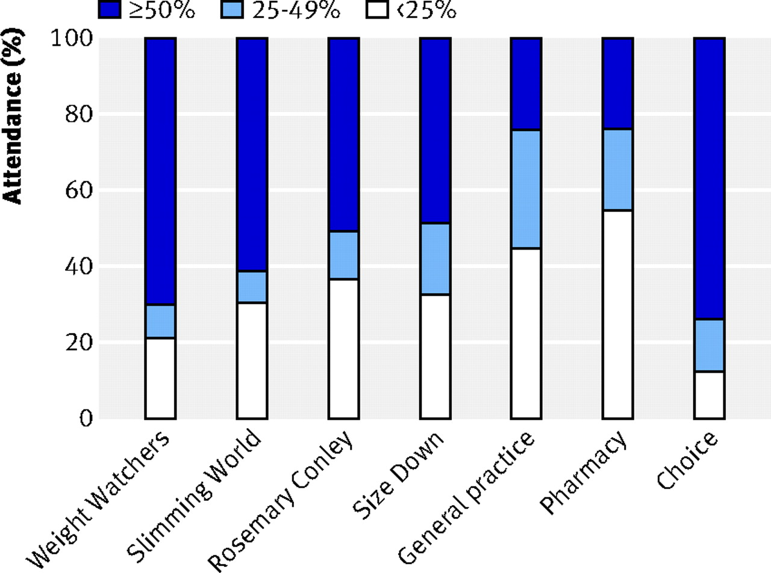

Fig 2 Proportion of scheduled weight loss programme sessions attended.
Jolly K et al. BMJ 2011;343:bmj.d6500
©2011 by British Medical Journal Publishing Group
Notes:
Fig 2 Proportion of scheduled weight loss programme sessions attended

Slide 18
Commercial providers vs Primary Care
Programme end
  Commercial group lost 2.3kg (1.3 to 3.4) more than primary care (p=0.004)
One year
  Commercial group lost 1.7kg (0.5 to 3.0) more than primary care (p=0.02)
  Primary care mean weight loss 0.8 (4.7)kg
  Commercial programmes mean loss 2.5 (6.2) kg
Commercial programmes were less costly

Slide 19
Comparison with other studies
Weight Watchers
Primary care
Study | Intervention duration | Weight loss (BOCF)
Lighten Up | 12 weeks | 3.46 kg
Jebb | 1 year | 4.03 kg
Truby | 6 months | 4.52 kg
Heshka | 1 year | 3.51 kg
Study | Intervention duration | Weight loss (BOCF)
Lighten Up | 12 weeks | 0.86 kg
Counter-weight¹ | 1 year + | 1.34 kg
Hardcastle² | 6 months | 0.7 kg
Nanchalal³ | 12 weeks | 3.19 kg
Nanchalal² | 6 months | 0.78kg
All followed-up at 1 year
¹ Included group element
² Follow-up at 6 months
³ Follow-up at 3 months

Slide 20
Which weight loss programmes are as effective as Weight Watchers: non-inferiority analysis
Madigan CD, Daley AJ, Lewis AL, Jolly K, Aveyard P.
British Journal of General Practice 2014;64:e128-e136

Slide 21
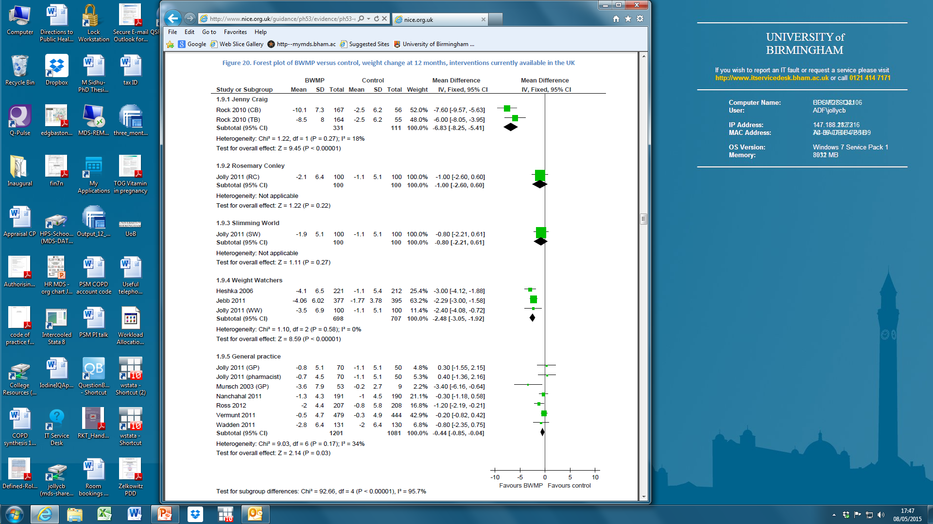
NICE PH53. Managing overweight and obese adults: update review. The clinical effectiveness of long-term weight management schemes for adults. Hartmann-Boyce et al. University of Oxford 2013

Slide 22
Study design
Observational study using participant records from the Lighten-Up service database
Lighten Up participants could attend Weight Watchers, Slimming World, Rosemary Conley and an NHS group-based programme.
Most RCT evidence was available for Weight Watchers, which does lead to weight loss
We set 1kg difference at 3 months and 0.7kg at 1 year as ‘non-inferior’

Slide 23
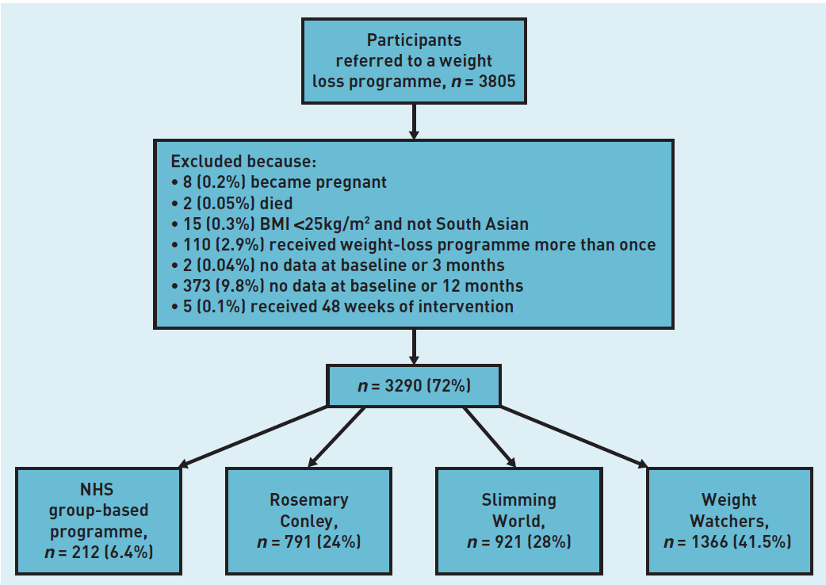

Slide 24
Characteristics of Participants
 | Weight Watchers | Slimming World | Rosemary Conley | NHS group
Mean age (sd) | 48.9 (15.2) | 49.6 (14.5) | 50.1 (14.4) | 57.7 (14.4)
Male (n (%) | 166 (12.2) | 123 (13.4) | 91 (11.5) | 56 (26.4)
Non-white ethnic group n (%) | 187 (13.7) | 94 (10.2) | 208 (26.3) | 40 (18.9)
Mean BMI at start (sd) | 35.2 (5.8) | 35.7 (6.1) | 34.3 (5.1) | 34.5 (5.5)
Maintenance intervention received | 381 (27.9) | 277 (30.1) | 185 (23.4) | 49 (23.1)

Slide 25
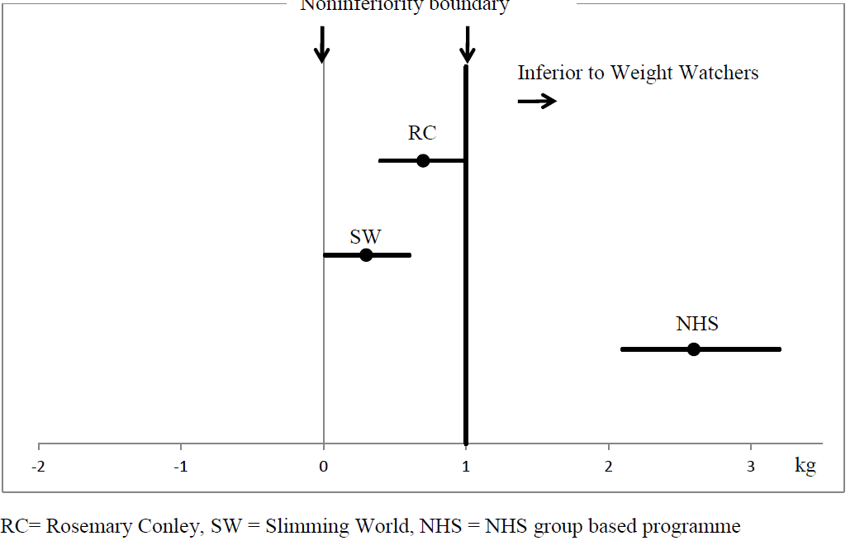
Non inferiority analyses of observational data at 3 months

Slide 26
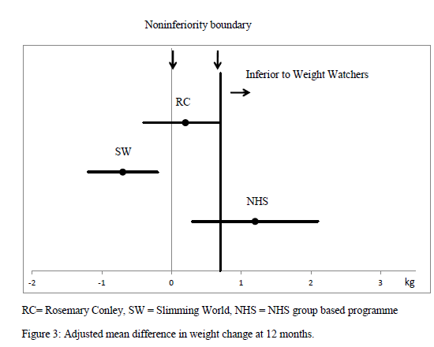
Non inferiority analyses of observational data at 12 months
Notes:
We recognise in weight loss studies the difference in weight between treatments decrease as time passes because most participants regain weight and therefore mean weight loss curves tend to converge. At 12 months we set the margin at 0.7 kg to take this into account. However as before the margin can be moved to your preference.
The results slightly differed at 12 months. Rosemary Conley and Slimming World were classified as noninferior the same as three months, however Slimming World participants lost more weight than Weight Watchers. The data for the NHS group programme was inconclusive as the confidence intervals overlapped the noninferiority margin.
The results suggest that commercial programmes result in similar weight losses and we would advocate that public health authorities commission all three commercial weight loss programmes since all result in similar amounts of weight loss and the choice is likely to extend the take-up of these programmes.

Slide 27
Conclusions of non-inferiority analysis
In the short term all commercial weight loss programmes appeared to result in similar weight loss but the NHS alternative appeared to produce less weight loss.
At 12 months Slimming World led to greater weight loss but the differences between commercial programmes was small and of minor clinical importance.

Slide 28
Weight regain after 3-month programme
NICE PH53. Managing overweight and obese adults: update review. The clinical effectiveness of long-term weight management schemes for adults. Hartmann-Boyce et al. University of Oxford 2013

Slide 29
Regular self-weighing to promote weight maintenance after intentional weight loss: a quasi randomised controlled trial
Madigan C.D, Aveyard P, Jolly K, Denley J, Lewis AL, Daley AJ. Journal of Public Health (epub). doi: 10.1093/pubmed/fdt061

Slide 30
Aims and Methods
To examine the effectiveness of a weight maintenance intervention focused on regular self-weighing after receiving a 12-week weight loss programme.
Controlled trial of 3768 obese or overweight men and women.
The intervention group (n=3290) received two telephone calls, the offer of free weighing scales, encouragement to weigh themselves weekly and record this on a card.
Comparator group (n=478) had no contact between 3 and 12 months
Main outcome - change in weight between 3 and 12 months. Weight largely self-reported at 12-months

Slide 31
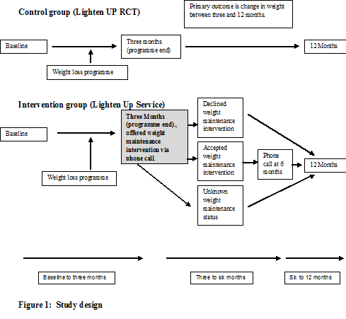

Slide 32
Results: all intervention group
Average loss at 3 months 4.8kg
Notes:
Explain findings
What it means....

Slide 33
Results: participants who accepted maintenance intervention
Control regained 1.83kg
Average loss at 3 months 4.8kg
Intervention acceptors lost further 1.93kg
Notes:
Explain findings
What it means....

Slide 34
Conclusions and Implications
A pragmatic weight loss maintenance intervention that encourages self-weighing as well as a hints and tips booklet reduces weight regain after intentional weight loss.
This could become part of routine follow-up.
BUT this research is only observational and needs to be followed by randomised controlled trial encouraging self-weighing

Slide 35
Lighten Up Plus:
A randomised controlled trial
Manbinder Sidhu, Amanda Daley, Kate Jolly
University of Birmingham

Slide 36
Principal research question
How does an SMS-text messaging based weight maintenance programme to encourage self-weighing compare to a brief telephone supported programme in terms of weight change at 3 and 9 months after the end of the 12 week weight-loss programme?

Slide 37
Method
Design
  Randomised controlled trial with 380 patients individually allocated to one of two weight maintenance programmes: usual care or text intervention
Population
  Patients registered with general practices in Birmingham who have taken up the offer of the free 12-week Lighten Up weight management programme
  Inclusion: Aged ≥18, attended minimum 9/12 sessions of weight management service, access to scales and telephone
  Exclusion: Non English speakers, women who are pregnant, not willing to be randomised

Slide 38
Outcomes and assessments
Primary outcome
  Difference between baseline weight and independently measured weight at nine months following randomisation
Secondary outcome
  Self reported weight loss at 3 months following randomisation

Slide 39
Text Intervention
BCT components
Text intervention
Based on encouraging weekly self-weighing
Monitoring of weight loss by other ‘person’
Feedback of outcome of the behaviour
Setting weight loss/maintenance target
Invitation text
Welcome to the service text
Weekly request for weight and whether they had lost or gained weight
Congratulation/ acknowledgement of weight loss, maintenance or gain
Monthly motivational text
End of service text at 13 weeks

Slide 40
Baseline Characteristics
 | Intervention N=190 | Control N=190
Age - mean (SD) | 47.7 (13.1) | 47.0 (13.7)
Males - n (%) | 20 (10.5) | 19 (10.0)
Ethnic group – n (%) White British/Irish Other ethnic groups/mixed | 151 (80.7) 36 (19.3) | 151 (81.6) 34 (18.4)
Weight on joining Lighten Up / kg | 99.8 (17.4) | 99.1 (16.6)
Weight at start of maintenance / kg | 93.4 (16.2) | 92.8 (15.9)

Slide 41
Weights returned

Slide 42
Requests to opt out
31 participants (16.3%) requested to stop receiving text reminders
  10 did not engage (sent no weights, opted out quickly, usually <1 week)
  5 received 15+ texts but responded to none except agreement to join
  16 sent weights before opting out

Slide 43
Weight change at 3 months
 | Intervention | Comparator | Mean difference (95% CI)
Crude weight change /kg | -1.92 (4.44) n=153 | -1.76 (5.59) n=156 | -0.15 (-1.28, 0.98)
Weight change with missing data imputed¹ | -1.87 (3.99) n=190 | -1.85 (5.08) n=190 | -0.12 (-1.04, 0.79)
¹Missing data imputed with mean weight change for usual care group; Self-reported data
Follow-up rates: Intervention 80.5%; comparator 82.1%

Slide 44
Weight change at 9 months
 | Intervention | Comparator | Mean difference (95% CI)
Crude weight change /kg | 1.02 (8.32) n=109 | 1.81 (7.65) n=118 | -0.80 (-2.87, 1.28)
Weight change with missing data imputed¹ | 1.36 (6.24) n=190 | 1.81 (6.02) n=190 | -0.45 (-1.67, 0.78)
¹Missing data imputed with mean weight change for usual care group;
Follow-up rates: Intervention 57.4%; comparator 62.1%

Slide 45
Self-management behaviours
 | 3 months |  | 9 months
 | Intervention N (%) | Comparator N (%) | Intervention N (%) | Comparator N (%)
Weighing at least once/week | 124 (82.1) | 112 (72.2) | 63 (64.9) | 73 (69.5)
Currently attending a commercial weight loss programme | 83 (55.0) | 64 (41.3) | 42 (44.7) | 45 (44.8)

Slide 46
Conclusions
Evidence of engagement with self-weighing and feedback of weights in intervention group
No evidence that an SMS based weight maintenance intervention affected weight 3 or 9 months after a free three month commercial programme ended
High level of continued participation with commercial programmes after free programme ended

Slide 47
Ongoing and future trials
ONGOING TRIALS:
Healthy Dads, Healthy Kids UK
  Funded by NIHR PHR
LIMIT: PI Dr Amanda Daley
  Funded by NIHR PHR
BWel: PI Professor Paul Aveyard
  Funded by NPRI
POPs2: PI Dr Amanda Daley
  NIHR SPCR and West Midlands and Oxford CLAHRCs
CHANGE: PI Dr Miranda Pallan
  Funded by NIHR HTA

Slide 48
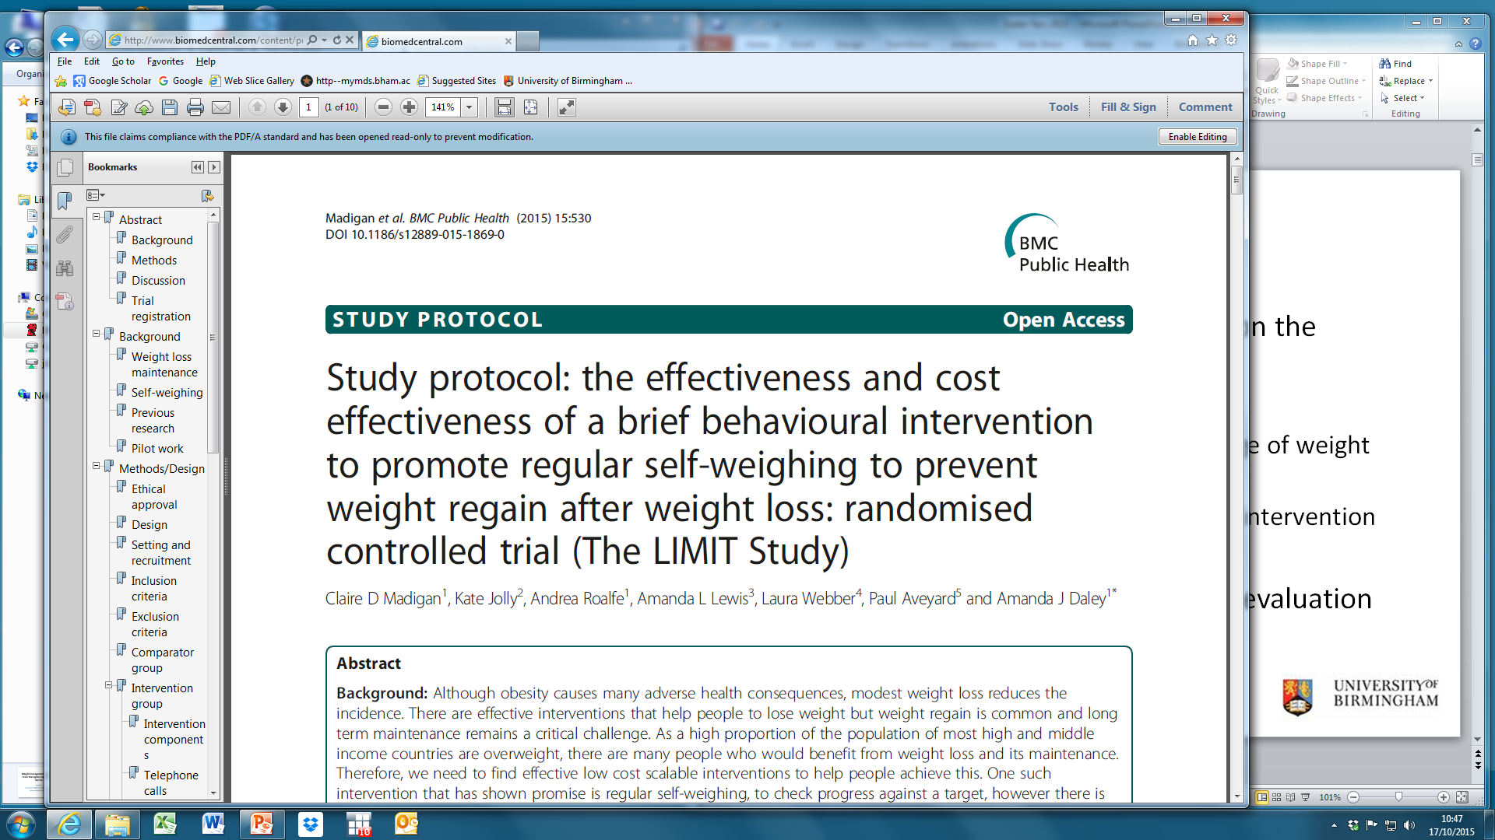

Slide 49
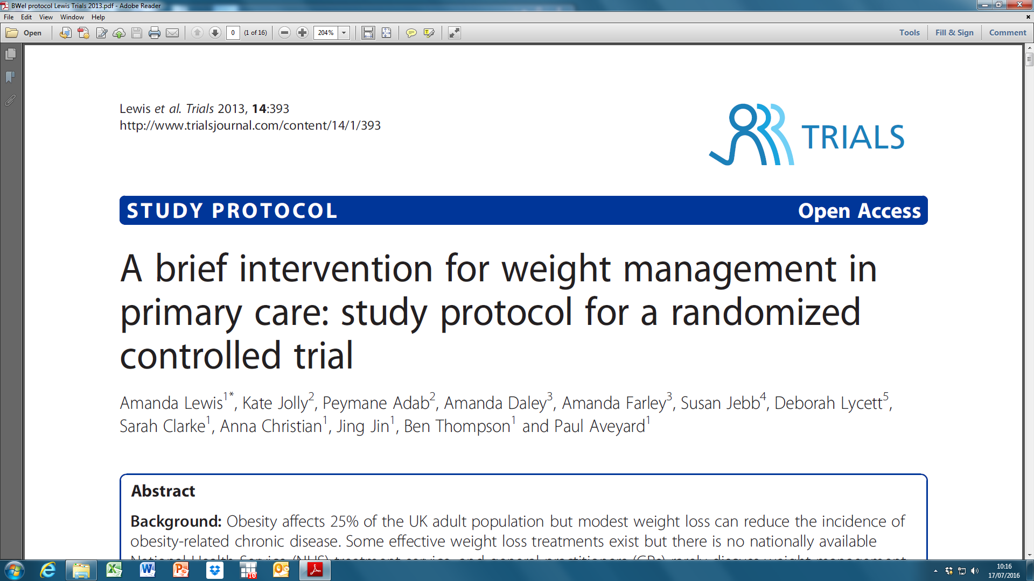

Slide 50
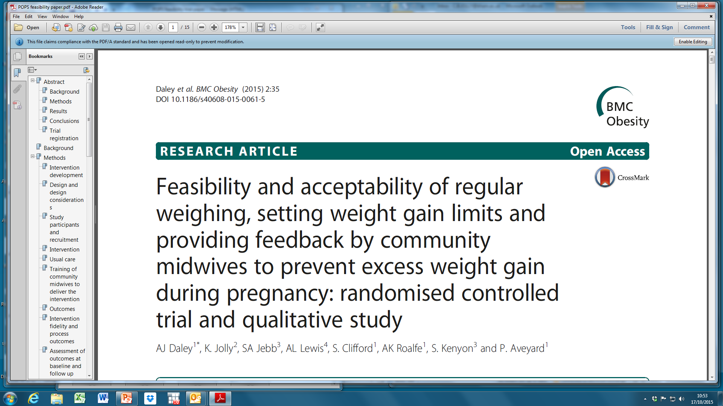
Preventing Obesity in Pregnancy Study (POPS)

Slide 51

Healthy Dads, Healthy Kids
Cultural adaptation and feasibility trial of a successful dietary and physical activity programme for ‘fathers’ and their children
9 group-based sessions (7 for children and 2 for partners) usually held in schools
  30 mins ‘education’: diet, activity, parenting
  60 mins physical activities, games and rough and tumble
Based on Social Cognitive Theory and Family Systems Theory

Slide 52
Morgan P et al
Pilot: HDHK dads lost 7.6kg (95% CI 6.0, 9.2 ) more at 6 months (IJO 2011;35:436-447)
RCT (Prev Med 2014;):
  mean diff in weight loss 3.4kg (95% CI 2.1, 4.7) at 14 weeks;
  children’s BMI z-score reduced by 0.1 (0.21,0.0) in HDHK arm and increased PA
Community implementation: 4kg loss at 1 year in dads; BMI z-score (-0.13, 95% CI-0.20,-0.05) in children

Slide 53
HDHK UK
Cultural adaptation
  Qualitative interviews, adaptation of materials, using Lui et al’s Typology of Adaptation of health promotion interventions to meet the needs of ethnic minority groups (HTA 2012;16 (44))
Non-randomised feasibility study
Randomised feasibility trial

Slide 54
Acknowledgement
This work was funded by the NIHR through the Collaborations for Leadership in Applied Health Research and Care West Midlands (CLAHRC-WM) programme, The NIHR School for Primary Care Research and Birmingham Public Health. The views expressed in this publication are not necessarily those of the NIHR, or the Department of Health.

