Slide 1
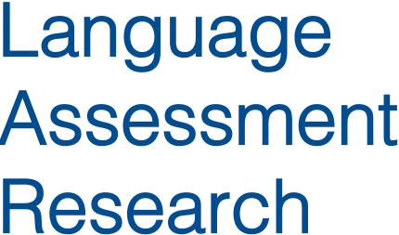

Re-conceptualising Validity in High Stakes Testing
Barry O’Sullivan | British Council
Invited Seminar
February 11th 2015
University of Exeter

Slide 2
Overview
Validity as a concept & theory
Validation as an argument
Revisit validation
Rethink content
Validation audience
Conclusions

Slide 3
A concept
what is validity?

Slide 4
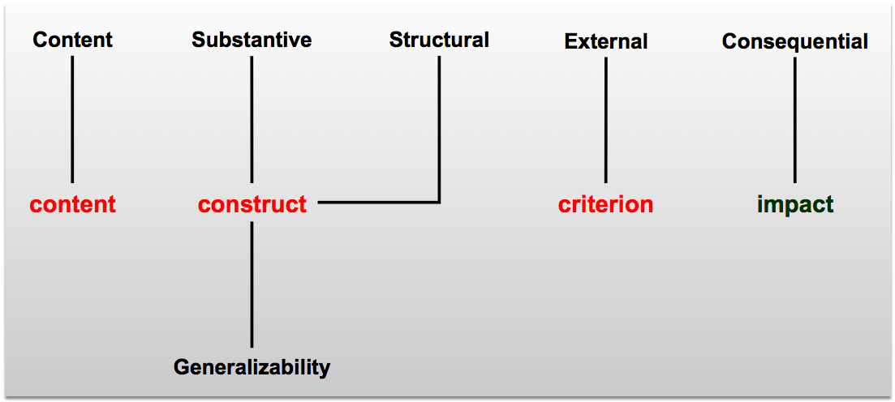
What do we mean by Construct?
Construct validity
Content validity
Criterion validity
Construct validity
Content
Content Substantive Structural External Consequential
Construct-related
Content-related
Criterion-related
Generalizability
Notes:
1. Test-focused -

Slide 5
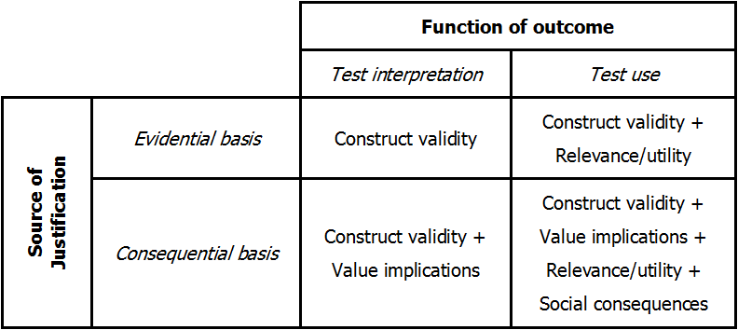
Messick’s Retreat to Construct
Notes:
1. Test-focused -

Slide 6
Construct – specific or broad?
Construct as a trait or ability
VALIDITY
Construct as nomological network
Notes:
1. Test-focused -

Slide 7
Are Tests Valid or Not?
A property of the test
[focus on test]
TEST
VALIDITY
A property of the decisions based on the test performance
[focus on use]

Slide 8
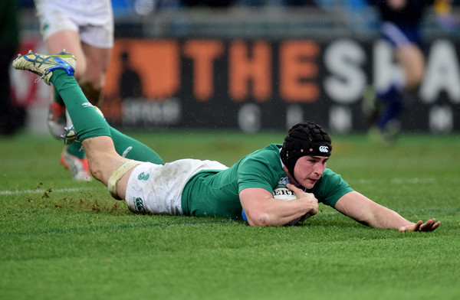
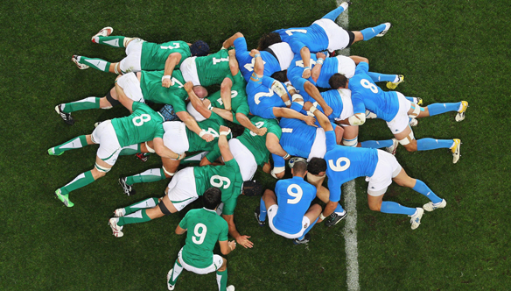
Validity – State of Play
Back to basics
Does the test work?
Does the test work in this context for these decisions?
Enough focus on context?

Slide 9
Validity – Validation
Approach
Positives
Negatives
Cronbach & Meehl
Conceptually clear & easy to operationalise
Encouraged limited view of evidence required; simplistic
Messick
Broad scope, with unitary view and recognition of need for non-test evidence
Elements unclear and open to interpretation [generalizability & consequence]; impractical
Weir
Based on Messick, generally practical to operationalise
Temporal notion suspect; consequential & criterion not integrated; impractical
O’Sullivan & Weir
Based on Weir/Messick, based on 8 years of practical implementation
Concept of consequential [social values] not explicit; overly simplistic

Slide 10
Validity - Development
Approach
Positives
Negatives
Alderson et al.
Early attempt to conceive of link between validation and development
Atheoretical; collection of individual elements with no attempt to understand how they are linked; impractical
O’Sullivan & Weir
Has been extensively used for all aspects of development
Unclear as to how it deals with aspects such as social values & consequences
Mislevy et al.
Conceptually solid, appears practical
Too many elements left undefined so difficult to operationalise; unclear as to how it deals with aspects such as social values & consequences

Slide 11
An Argument
how do we present our evidence?

Slide 12
Validity - Argument
Approach
Positives
Negatives
Kane
Systematic attempt to structure a validity argument
Not validity theory dependent
Audience unclear [academic or legal or both]; based on a US legal argument, may not be practical elsewhere
Bachman & Palmer
Application of a Kane-like approach
Highly structured
Unclear as yet if it is operationalisable or if the approach is appropriate for local contexts
Cronbach & Meehl, Messick, Weir, O’Sullivan & Weir
Attempt to highlight what the contents of an argument might be
No indication of how a validation argument might be structured

Slide 13
Validity - Argument
Oxford English Dictionary
A reason or set of reasons given in support to an idea, action or theory
To convince an individual or individuals
Questions
Who are we trying to convince?
What are we trying to convince them of?

Slide 14
Who Are We Trying To Convince?
Cronbach & Meehl
Messick
Weir
O’Sullivan & Weir
Bachman & Palmer
Etc.
Kane
Bachman & Palmer [?]
Lawyers
Academics
Academics
Developers
Psychometricians

Slide 15
What are we trying to convince them of?
The Test is Good
The Test is good enough to make decisions about candidates in this particular context

Slide 16
revisiting validation
focus on one model

Slide 17
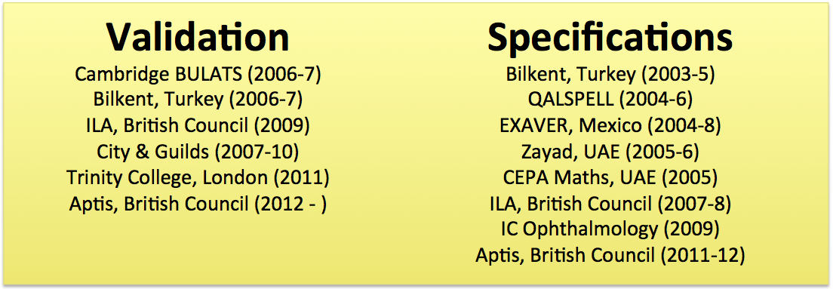
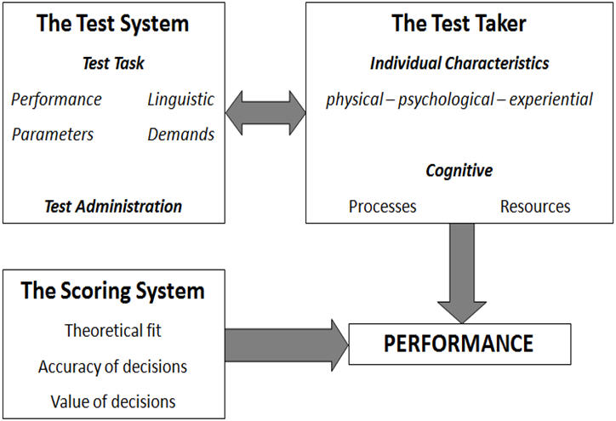
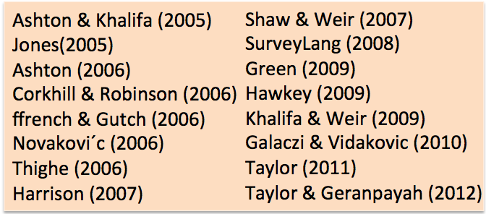
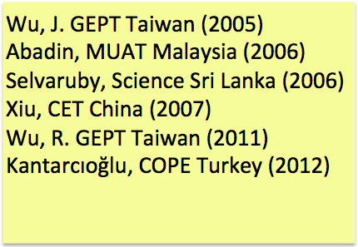
O’Sullivan (2011) – from Weir (2005)

Slide 18
Gathering Evidence
APA 1999
Evidence based on:
Test Content
Response Process
Internal Structure
Other Variables
Consequences of Testing
Messick
Content
Substantive
Structural
Generalizability
External
Consequential

Slide 19
The Key Issues
The model does not deal fully with
Consequence
The ‘socio’ element
Audience
Solution
Recognise in the model how things like social values and known test-related factors impact on test performance and perception
Solution
Explore and apply cognitive and socio relationships
More explicitly describe the interactions between the in-test audience and the in-test test taker
Solution
Recognise that there
IS
an audience issue
THEN
identify the audience(s)
AND
create the message(s)

Slide 20
Reconceptualising the Socio-Cognitive Model
Cognitive
Ability-in-language
&
Language User in Context
Socio-Cognitive Weak
Ability-in-language
of
Language User in Context
Socio-Cognitive Strong
Ability-in-language
is part of
Language User in Context

Slide 21
Rethinking context
linking context and consequence

Slide 22
CONTEXT OF USE
Examination
Boards
Test Taker
Schools
Boards
Principals
Administrators
Test
Administrators
Domain Experts
Lawyers
Education
Boards
Domain Participants
Teachers
Employers
Test
Developers
Parents &
Guardians
Academics
Broader Society
Broader Society

Slide 23
Is the concept of validation appropriate?
The theoretical definition of validation is too limited
Efforts to simplify the concept result in evidence that is, itself too simplistic and ignores context [and stakeholders]
How can the context, as expressed by stakeholder needs or expectations be reflected in our models?

Slide 24
Considering the Stakeholders
Apply the concept of social values in test development
[suggested by Messick but never operationalised]
Consider how validation evidence might be reported to stakeholders

Slide 25
Rethinking consequential evidence
Consequence/Impact
Test Takers
Parents & Guardians
Employers
Teachers
School Principals
School Administrators
School Boards
Examination Boards
Test Administrators
Education Boards
Broader Society
Test Developers
Academics
Lawyers
Consequence/Impact

Slide 26
In Practice?
Identify Test Context
Identify Critical Stakeholders
Define Construct
Develop & Administer Test
Monitor & Evaluate
Report

Slide 27
validation audience
alternative reporting

Slide 28
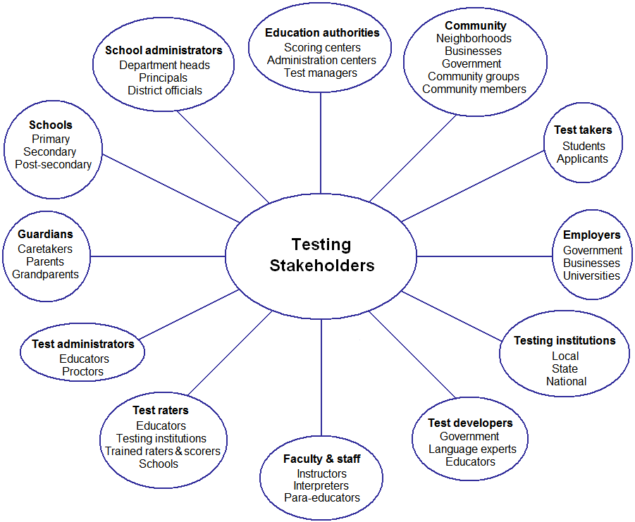
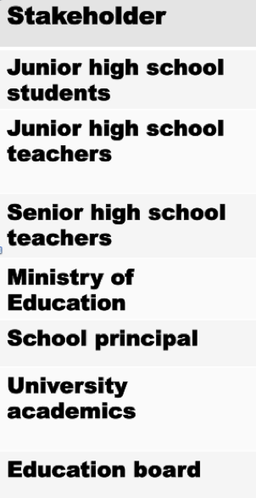
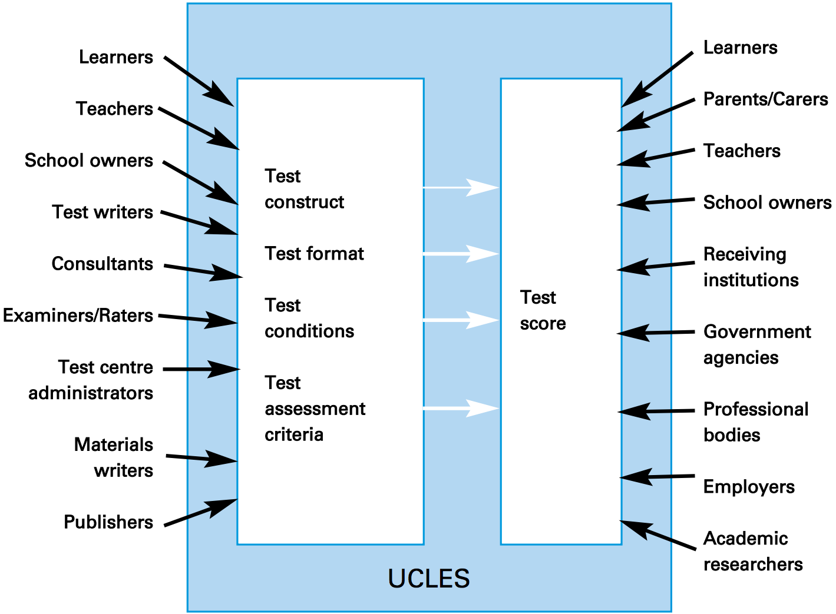
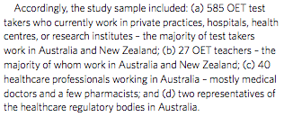
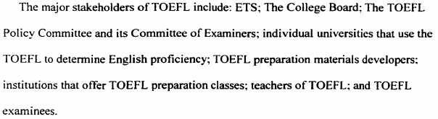
Thinking of Stakeholders
Akiyama (2014)
CAL (2009)
Taylor (2000)
Vidakovic & Khalifa (2013)
Roberts (2000)

Slide 29
Notice Anything?
None of the lists are the same
This suggests that
Different tests will have different stakeholder groups
Test developers do not systematically take stakeholders into account

Slide 30
Current Foci for Validity Arguments
Law Related
Lawyers
Judges
Other Legal
Traditional validity arguments focuses more or less exclusively on these
CAL (2009)

Slide 31
Additional Foci Required
And the Rest?
What do we need to tell them about?
What sort of language should we use?
What medium should we employ?
CAL (2009)

Slide 32
Thinking about Stakeholders
It is very unlikely that all stakeholders will share the same concerns
Even where concerns are shared, their relative importance will vary
Different stakeholder groups may have different interpretations of what issues mean to them [e.g. reliability]
Different stakeholder groups will require different arguments which are stakeholder-specific and are delivered in such a way that the stakeholders can understand and interpret them

Slide 33
Conclusions
dealing with the issues

Slide 34
The New Reality
Stakeholder Groups
Different concerns
Different understandings
Different levels of Assessment Literacy
Different experiences of texts in L1
Different communication patterns
Different expectations of delivery

Slide 35
Three Points to Consider
Thinking around validation must change
Our current conceptualisation of validation reporting is too limited in that it assumes a limited and highly technical audience
We have tended to become too elitist
We have been talking to each other about validity for almost a century, it’s time to accept that there are others who need to be included and/or informed
We must accept change
In order to communicate appropriately we need to work with specialists who know how to communicate to our stakeholders

Slide 36
Rethink Models
Social Context
Evidence Gathering
Evidence Reporting

Slide 37
Rethink Communication
If we wish to report directly to stakeholders we cannot use a language they do not fully comprehend
Similarly, we must deliver our communications in modes accessed by these stakeholders
Who will create the communications?
How will these be delivered?

Slide 38
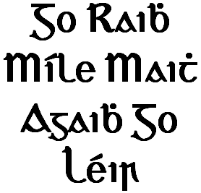
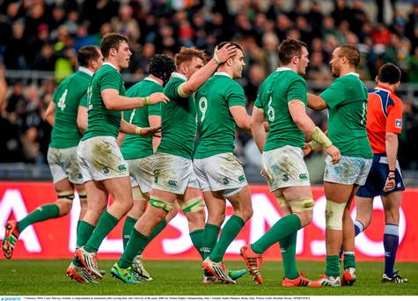
barry.o’sullivan@britishcouncil.org

