Slide 1
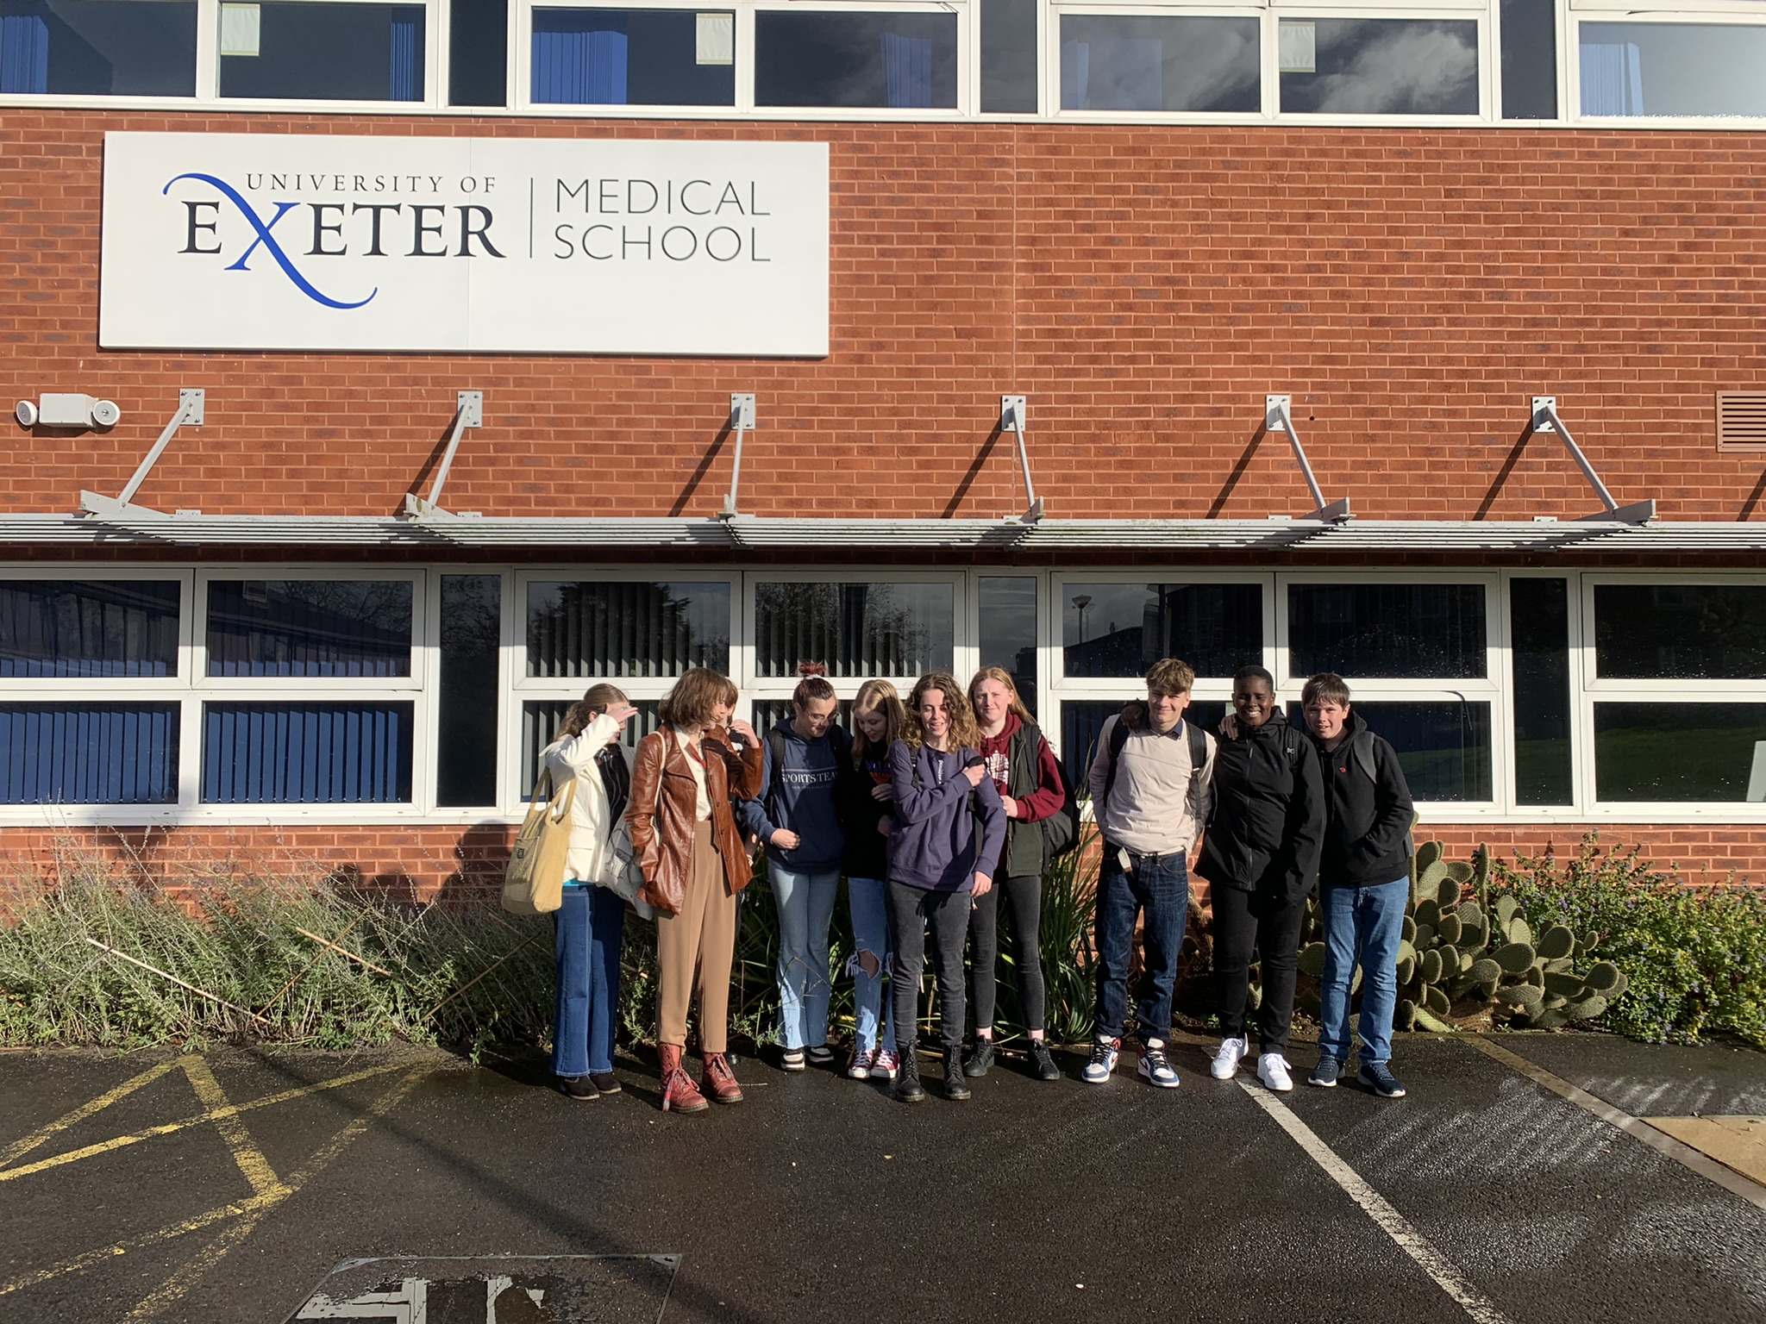
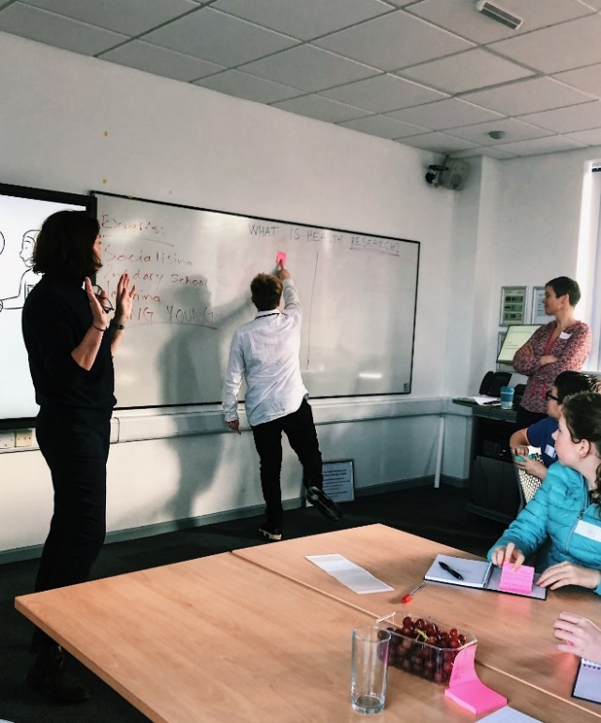
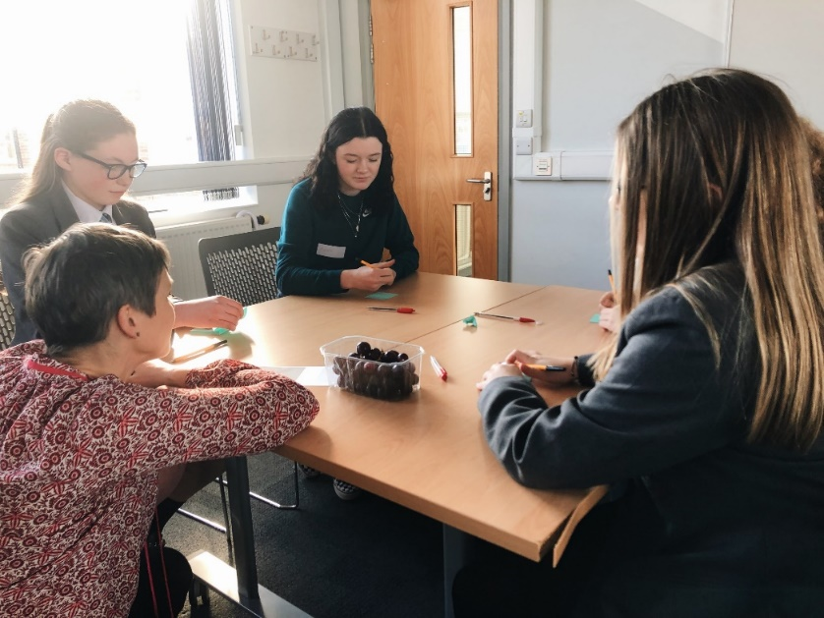

Young Person’s Advisory Group -YPAG
Camilla Forbes, Research Fellow for the NIHR South West Peninsula Applied Research Collaboration (PenARC)

Slide 2
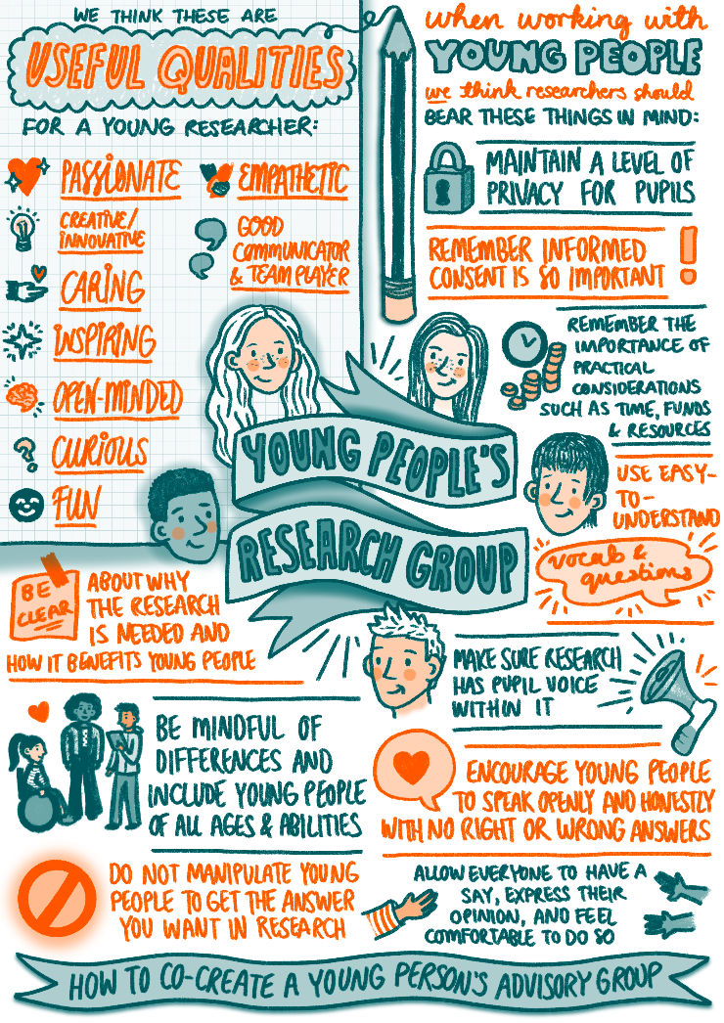

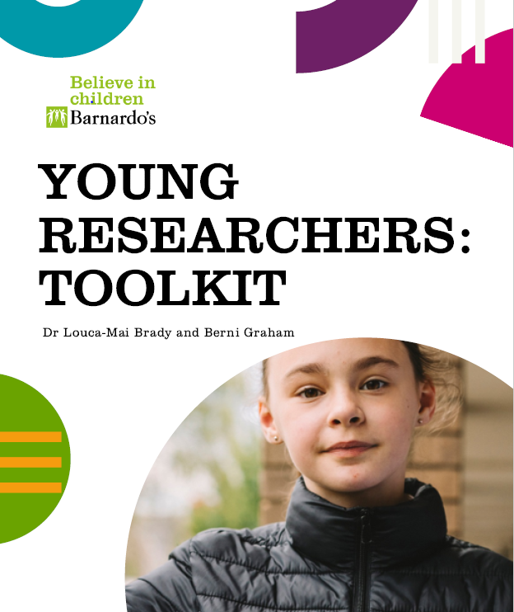

Children & Young People's Wellbeing @ Exeter

Slide 3

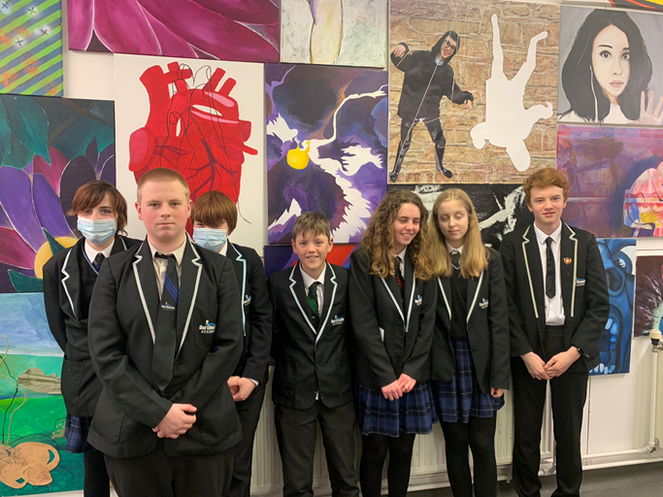
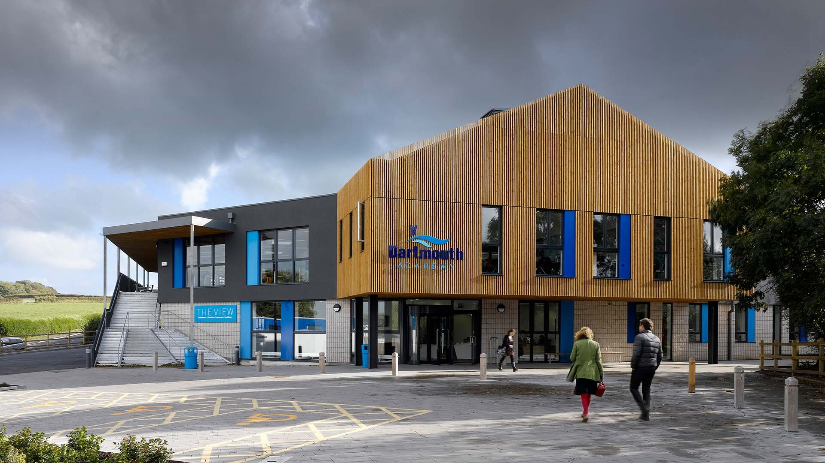

Dartmouth YPAG

Slide 4
Practical considerations
TIME! TIME! TIME!
Flexibility
Be realistic…and fun!
Incentives
Communication
Funding
Space
Equality

Slide 5
Ethical considerations- questions to ask yourself
Is it clear to YP what is involved by being part of the group?
Are the aims of the group clear?
Agree how you will work together?
What are the power dynamics of the group and how will you equalise?
How will you manage their expectations about research?
In what ways can you avoid tokenism?
Are you REALLY willing to make changes to your work?
Have you considered all the ethical implications of working with the group
Have you informed parent/carers of the groups aims and activities?

