Slide 1

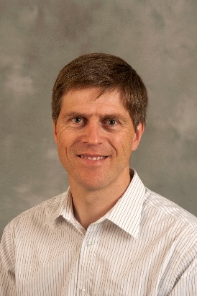
Date: 26 September 2018 Time: 13.00-14.00 venue: Room JS07, Smeall Building, St Luke’s Campus
Join us afterwards for our informal monthly APEx meeting: updates on progress in APEx and networking (refreshments will be served)
Email: j.l.Choules@exeter.ac.uk to book your place
For further information visit: www.exeter.ac.uk/medicine/apex/seminars
APEx Seminar Series
Professor Tony Avery
Dean and Head of Medical School, University of Nottingham
Making a difference with your research: towards improving patient safety in primary care
We all want our research to have an impact on the world, whether that be through improving knowledge of the best ways of diagnosing and managing conditions in primary care or understanding how best to organise primary care and its interfaces with other sectors. The key, however, is to influence policy, which is not an easy thing to do. In this seminar, Tony Avery will give an overview of his research into patient safety in primary care over the last 20 years, particularly focusing on the development and evaluation of a prescribing safety intervention (called PINCER) which is now on the cusp of being rolled out nationally.

