Slide 1
EPSRC Update
Exeter
December 2017

Slide 2
What we will cover today:
EPSRC and UKRI
Questions- at the end- or contact us.
Healthcare Technologies in EPSRC –impact toolkit
There are no stupid questions (unless you haven’t read the call document…..)
Funding opportunities
Global challenges (GCRF) and Industrial Strategy (ISCF)
Challenge funds:
Notes:
Apologies for Jargon – hopefully all will become clear as we go through.
There is too much to cover so there are a lot of hidden slides I can’t show- so please go back through when these are sent round for useful reference material.

Slide 3

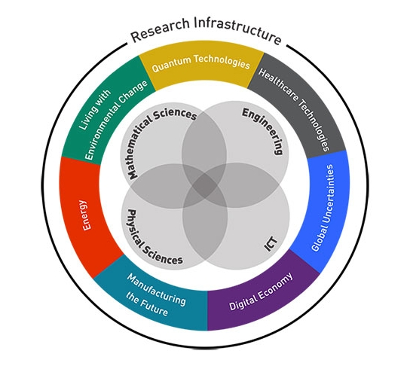


Investing in world leading research

Slide 4

EPSRC Strategic Plan
One vision……
Our vision is for the UK to be the best place in the world to research, discover and innovate
Two goals…..
RESEARCH and DISCOVER
RESEARCH and INNOVATE
Three strategies…..
Balancing capability
Building leadership
Accelerating impact
Notes:
EPSRC’s strategic plan was evolved around 2 years ago when Phil Nelson became our CEO. He eanted to express what is is that EPSRC, as a low TRL funder, is here to do.
We have the vision for the UK to be the best place in the world to research, discover and innovate.
RESEARCH AND DISCOVER means that we want the UK to be
an international research leader, where discovery thrives and our support generates the highest quality research in engineering and physical sciences.
RESEARCH AND INNOVATE means that we want the UK’s
excellent research base and talented researchers to work with us to accelerate innovation for the benefit of society and the economy
There are 3 strategies:
Balancing capability- I think of as being a smart investor in research
Building leadership is investing in people at all career stages
Accelerating impact is reducing the time from discovery to innovation.

Slide 5

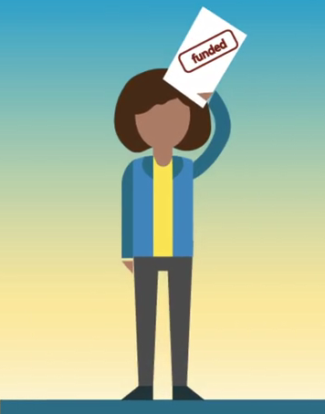
Case for publicly funded science
Successful nations invest in
science and engineering
Public Investment
Investment in Research Councils
£1 spent by government in R&D raises private sector R&D output by 20p per year in perpetuity
Scientists who hold Research Council grants are more likely to interact in the wider community and have research applied in a commercial context
SCIENCE
FOR SUCCESS
There are substantial spillover effects from Research Council funding but not from private sector funding or other sources of funding
Notes:
The Economic Significance of the UK Science Base, a report for the Campaign for Science and Engineering.

Slide 6


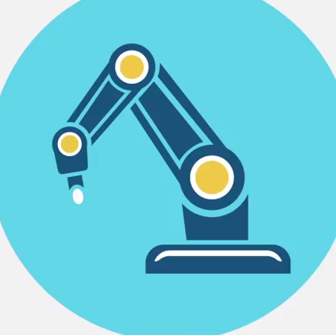
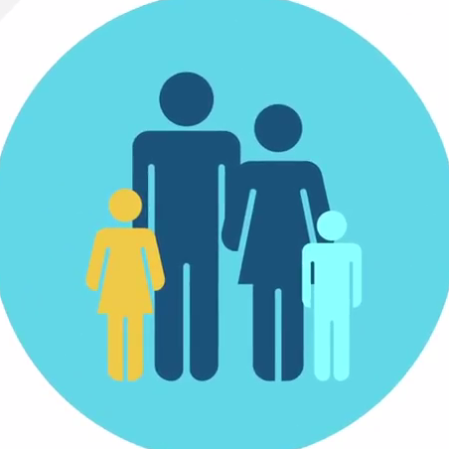
EPSRC Delivery Plan
World class laboratories
UK Research And Innovation
Global Challenges Research Fund
Institutes
Alan Turing
Physical Sciences
Royce
UKCRIC
Strategies
Balancing Capability
Building Leadership
Accelerating Impact
Our Portfolio
Research
Skills
Impact
Notes:
The Outcomes are a means of externally communicating what EPSRC’s research investments actually deliver.
They aim to provide a simple framework in a complex landscape – so the overall portfolio, the strategies and the institutes EPSRC have been asked to deliver, all contribute to these Outcomes in some way or other.
This slide shows all the components of the Delivery Plan
Science Strategy (Productive, Connected, Resilient and Healthy Nation)
EPSRC strategies (Balancing Capability, Building Leadership, Accelerating Impact)
Grand Challenges (Institutes, including Alan Turing, Physical Sciences, Royce and UKCRIC)
Capital plans (Word Class Laboratories)
Global Challenge Research Fund
Efficiency and effectiveness

Slide 7
HEALTHY NATION – Improved quality of life through better mental and physical health
H1: Transform community health and care
H2: Improve prevention and public health
H3: Optimise diagnosis and treatment
H4: Develop future therapeutic technologies
H5: Advance non-medicinal interventions
RESEARCH CAPABILITIES
Advanced materials
SKILLS & LEADERSHIP
Disruptive technologies for sensing and analysis
Future manufacturing technologies
Medical device design and innovation
Novel computation and mathematical techniques
Novel imaging technologies
Link to outcomes descriptions on EPSRC website
Link to Healthy Nation Convenor Interview
Notes:
Advances based on new research in EPS will revolutionise our ability to manage own own health, adopt healthier behaviours and environments and transform the way care is delivered.
Novel technologies, materials and understanding will improve our ability to diagnose, predict and treat disease leading to better quality of life, higher standards of care and will drive UK growth through new products and services as well as driving down the cost of healthcare.
The Healthy Nation Outcome build strongly on the work done to develop the Healthcare Technologies Grand Challenges strategy; but is broader than just HT. I’m going to go through the HT strategy in more detail later, so I won’t talk about each of the ambitions within the delivery plan at this point, apart from highlighting that the delivery plan incorporates the ambition H2- which makes the contribution of EPS to delivering improved prevention and public health, much more explicit.
For example, Civil Engineering research in the built environment and water engineering can contribute here through, for example, the design of smart and nurturing infrastructures which encourage healthy behaviours and support good mental health, or through better understanding of how drains and the water supply in hospitals could act as reservoirs for antibiotic resistant bacteria, or through how environmental remediation can improve health.
Healthcare Technologies research draws on, and contribute to the other Nations, for example on Connected Nation for data analytics and internet of things technologies, and contributes to both the Productive Nation and the Resilient Nation, for example in thinking about responses to pandemics.
Embedded links:
The weblink at the bottom lhs of the slide will take you to the relevant page on the EPSRC website, where you can find out more about all of the ambitions.
The weblink at the bottom rhs takes you to a recorded interview with me, explaining more about the Healthy Nation Outcome.

Slide 8
Healthy Nation Ambitions
AMBITION H1 | Transform community health and care
Using real-time information to support self-management of health and to facilitate timely interventions delivered through new models of care.
AMBITION H2 | Improve prevention and public health
Using technologies to understand and influence behavioural and environmental determinants of health and wellbeing, and to revolutionise built infrastructures to support healthy, independent living.
AMBITION H3 | Optimise diagnosis and treatment
Optimising care through effective diagnosis, patient-specific prediction and evidence-based treatment planning.
AMBITION H4 | Develop future therapeutic technologies
Supporting the development of novel therapies with technologies to enhance efficacy, minimise costs and reduce risk to patients.
AMBITION H5 | Advance non-medicinal interventions
Restoring function, and optimising surgery and other non-medicinal interventions to achieve high precision with minimal invasiveness

Slide 9
TOGETHER we have achieved so much…
Impact | Impact and Translation Toolkit
Calls | Sensing and Imaging for Diagnosis of Dementias (SIDD) Intelligent Technologies for Collaborative Care | Hearing Aid Technologies Healthcare Impact Partnerships
Critical Mass | Maths in Healthcare Centres IRC mid-term reviews & next steps | Programme Grants
Talent | Healthcare Technologies Challenge Awards Revised fellowship strategy | HT Impact fellowships CDT mid term reviews and priority areas for next call Established Career Fellowship priorities
Community building | HT NetworksPlus
HT investigator led | Multidisciplinary responsive mode peer review
NIHR | I4i and EME | GCRF Diagnostics, Prosthetics and Orthotics
CRUK | Multidisciplinary Awards
NC3Rs | CrackIT!
Wellcome | Wellcome/EPSRC Centres
RCUK | Molecular Pathology Mental Health research agenda and call UKRMP- phase 1 and 2 |  | AMR- Bridging the Gaps between EPS and AMR AMRTheme 2 call co-funding UK Partnership for Prevention Research
EPSRC strategy | Healthy Nation |  | Balancing Capability
ISCF | Expecting announcements in budget

Slide 10

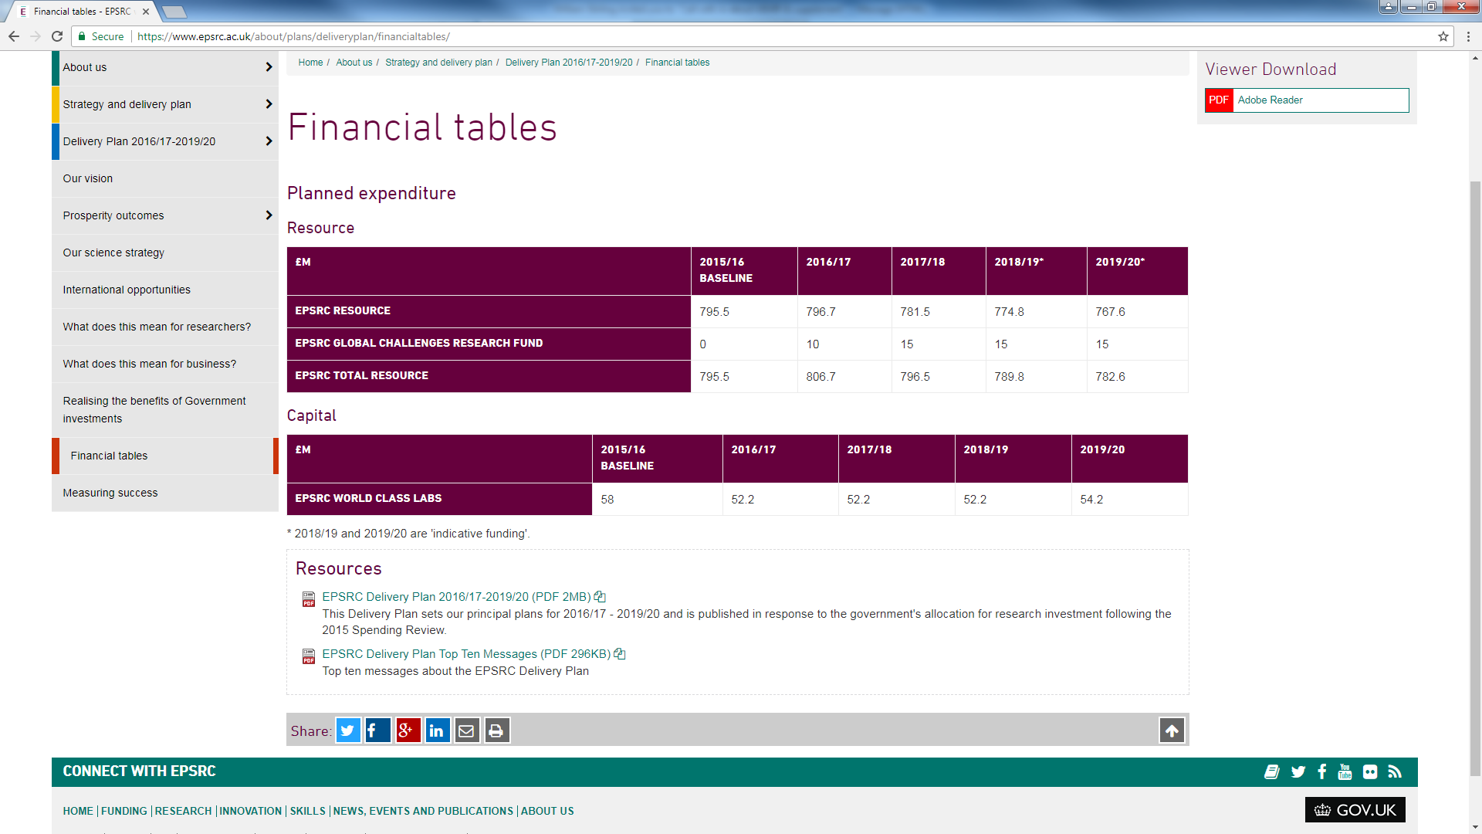
Delivery Plan – next steps
OUR
COMMITMENT
Notes:
Our forward look allocation figures directly affect what we are able to commission and as a result EPSRC needs to reduce its commissioning of new activities by around 15% in 2018/19, with a further reduction to 25% in 2019/20.
We have been aware of the need to reduce commitment from 2018/19 from the outset of our Delivery Plan and are now setting out what this means for our research community over the next few years.
Some things will remain unchanged:
We will continue to invest in excellent research and training across our whole portfolio maintaining a relative balance across both challenge and capability themes
We will maintain the current balance of investment between research and training
We will maintain a balanced portfolio of research, with 60% of our total research portfolio being community-led and 40% arising from strategic intervention
We will continue to invest in the research infrastructure needed to enable research excellence

Slide 11
EPSRC Delivery Plan
More opportunities for community-driven proposals
Focus on community-generated challenges
WHAT WILL
BE DIFFERENT?
More workshops to develop networks
More multi-disciplinary proposals
Fewer topic-specific and time-bound calls
Notes:
More opportunities for community-driven proposals
More calls which are focussed on community-generated challenges, or achieving particular behaviours or changes in the research environment
More workshops to develop community led challenges and networks
Fewer topic-specific and time-bound calls while still maintaining a balance between large critical mass investments, project grants and feasibility studies, networking etc.
More multidisciplinary proposals coming through peer review
For example:
New Approaches in Data Science call that has been driven by the community calling for a more holistic approach to Data Science across ICT, Maths and Digital Economy - highlights a range of areas but not an application domain
New ideas in energy call for feasibility studies aimed at drawing research from across the EPS into energy applications
Human Like Computing call/network+ following on from a community organised workshop
Healthcare technologies discipline hopping call to enable researchers to develop the skills need to address Healthy Nation ambitions and Healthcare Technology Grand Challenges

Slide 12
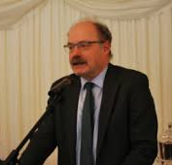

EPSRC and UKRI: A quiz question
Notes:
What connects the man on the left (Mark Walport) and the man on the right (Bob Dylan).
Answer: “The times they are a-changing”
Come gather 'round people
Wherever you roam
And admit that the waters
Around you have grown
And accept it that soon
You'll be drenched to the bone.
If your time to you
Is worth savin'
Then you better start swimmin'
Or you'll sink like a stone
For the times they are a-changin'.

Slide 13
“If your time to you is worth savin‘, Then you better start swimmin'
Or you'll sink like a stone,
For the times they are a-changin‘”. Bob Dylan
Challenge Directors for new Challenge Funds -Industrial Strategy. & Global Challenges
DARPA model
More monitoring- more deliverable driven
Grants
Or
contracts
??
Long term cf short term??
……..
More eligible ROs
Not just HEIs
Notes:
The time to influence change is now.
What to you want to keep?
Who do you tell, how can you influence?
Pay attention to the way things are changing

Slide 14
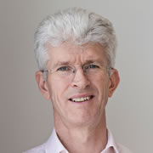
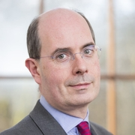
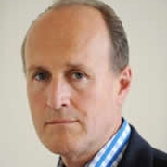
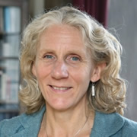
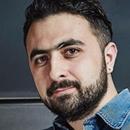
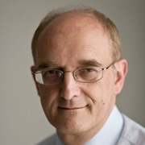

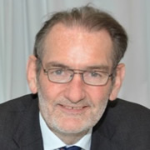

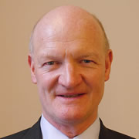

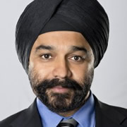
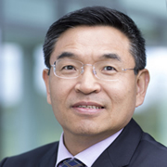

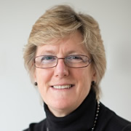
UKRI board
Notes:
Sir Mark Walport - Chief Executive Designate, UKRI
Ian Kenyon - Chief Finance Officer, UKRI
Sir John Kingman - interim Chair, UKRI; Legal and General Group Chair and former Second Permanent Secretary to HM Treasury
Sir Peter Bazalgette - founder of an independent TV production company and Executive Chair of ITV
Professor Julia Black - Pro Director for Research at the London School of Economics
Professor Sir Leszek Borysiewicz - Vice-Chancellor of the University of Cambridge (until end of September 2017) and Chair of Cancer Research UK
Lord John Browne of Madingley - Executive Chairman of L1 Energy, and former Chief Executive of BP plc
Professor Sir Ian Diamond - Principal and Vice-Chancellor of the University of Aberdeen
Fiona Driscoll - Chair, UKRI Audit Committee and Chair of Nuffield Health Audit Committee
Professor Alice Gast - President of Imperial College London
Sir Harpal Kumar - Chief Executive of Cancer Research UK
Professor Max Lu - President and Vice-Chancellor of the University of Surrey
Vivienne Parry - Head of Engagement for Genomics England
Mustafa Suleyman - co-founder and Head of Applied AI at DeepMind
Lord David Willetts - Executive Chair of the Resolution Foundation and former Minister for Universities and Science
Professor Dame Sally Davies - Chief Medical Officer
(As a serving civil servant, Dame Sally will not formally be a member of the Board but will join meetings in a personal capacity.)

Slide 15


Moving towards UKRI
EPSRC invests in the fundamental science that inspires multidisciplinary research
Cyber Security (Privacy, Ethics, Trust, Reliability, Accessibility and Security)
£9.7M multidisciplinary research hub
9 Leading UK Universities
RESEARCH
COLLABORATIVE
Treating Cancer
Multidisciplinary project award with
Cancer Research UK
Notes:
Treating cancer – CRUK multidisciplinary project award
Cyber security - Privacy, Ethics, Trust, Reliability, Accessibility and Security) a new £9.7 million multidisciplinary research hub in the cyber security of the Internet of Things involving nine leading UK universities

Slide 16
Fundamental Science – underpinning innovation
EPSRC invests in research for discovery and innovation, safe-guarding the excellence of the research base through long-term investment in community-driven research proposals that stimulate new ideas
and collaborations
90
OVER
Universities supported across the UK
56%
FUNDING
EXCELLENCE
of our portfolio is multi-disciplinary
60%
of our portfolio is community-led
40%
of our research led by strategic intervention

Slide 17
National Productivity Investment Fund
National Productivity Innovation Fund (NPIF) £4.7 billion
Approximately £425 million to be spent in 2017/18 rising to approximately £2bn in 2020-2021
Industrial Strategy Challenge Fund
Additional Funding to increase research capacity
Science and innovation audits (third wave)
Funding to increase university collaboration in technology transfer and working with industry £100m
Notes:
The Government committed to investing an extra £2 billion a year in R&D by the end of this Parliament – an increase of around 20% on total Government R&D spending, and more than any increase in any Parliament since 1979. This is a positive result. For UKRI this is an increase of a third in available budget. Is a clear indication that government support for science remains strong.
This National Productivity Innovation Fund (NPIF) will provide:
An Industrial Strategy Challenge Fund (UKRI/Innovate)
Additional Funding to increase research capacity (UKRI/Innovate)
A third wave of science and innovation audits
A further £100m until 2020-21 to increase university collaboration in technology transfer and working with industry
Approximately £425 million to be spent in 2017-18 rising to approximately £2bn in 2020-2021 (exact spend and fine details yet to be determined)
Additional Funding for Innovation, Applied Science and Research
To be allocated to increase research capacity and business innovation, to further support the UK’s world-leading research base and to unlock its full potential.
UKRI will award this funding on the basis of excellence
As yet there is little further detail available.
Industrial Strategy Challenge Fund (ISCF)
Cross-disciplinary fund to support collaborations between business and the science base, setting identifiable challenges to tackle.
The fund will be managed by Innovate UK and the Research Councils.
Modelled on the USA’s DARPA programme, it will cover a broad range of technologies, to be decided by an evidence-based process.
Blocks in darker blue on the left are of more interest to EPSRC

Slide 18
Industrial Strategy Challenge Fund (ISCF)
Managed by UKRI
Industry-led
Capitalise on UK strengths
powered by multi-disciplinary research and business-academic collaboration
Challenge driven
cuts across boundaries of research
Focus on areas with the potential to transform existing industries and create entirely new ones
Spend by March 21

Slide 19

EPSRC and the GCRF
Global Challenges Research Fund
£1,019M investment as part of 2015 SR:
  To address global challenges through disciplinary and interdisciplinary research
  To strengthen capability for research and innovation, within both UK and developing countries
  To provide agile response to emergencies and opportunities
  To enable cutting edge research which addresses the problems faced by developing countries
EPSRC’s allocation is £55M over 4 years:
  £10M 2016/17 allocation through institutional sponsorship grants to 35 universities
  £25M allocated to tackle global development
  challenges in engineering and digital
  technology research
  £20M still to invest
GLOBAL
INVESTMENT

Slide 20
CDT Call 2018
Planned budget £492m
represents flat cash (and therefore a similar number of CDTs)
dependent on confirmation from BEIS re baseline- November 2017.
If not, available budget £357m.
The requirement of a CDT approach as opposed to a need for doctoral training more generally, will be a key feature
CDTs are one of three current doctoral routes. EPSRC will look to make investments in CDTs where this doctoral training route specifically adds value.
Dual stream approach
with one for clearly identified priority areas
open stream -other areas where a case for the need for a CDT can be made.
balance between streams tbc but the majority of investment will be through the priority area stream with a smaller investment through the open stream.
town meetings in conjunction with the call launch. Dates will depend on the date for call launch but will be confirmed ASAP.
Decisions still to be made include
funding decisions December 2018
Case for CDT must be made
how to manage demand.
Exact approach to peer review including the consideration of strategic priorities.

Slide 21
The Healthcare Technologies Theme

Slide 22






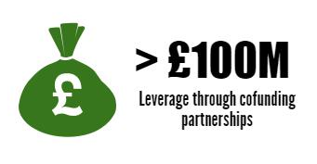





EPSRC Health portfolio
Notes:
From regenerative medicine to robotic surgery, data fusion to innovative drug delivery, EPSRC supported research and training makes a unique and vital contribution to a sustainable healthcare system, improved patient outcomes and quality of life.
EPSRC has a total portfolio of £725M of research and training relevant to Health, £336M of which is Healthcare Technologies funded.- not including joint funding from other partners e.g. Wellcome, CRUK, MRC, BBRSC, Innovate UK, NC3RS
Healthcare Technologies investments underpin advances in the NHS and provide opportunities for businesses in the health and life sciences sector.
Our portfolio covers Novel therapies, implants, surgical tools and prosthetics
It covers Sensing and imaging technologies, and data handling for diagnosis in real time and at point of care.
It also includes Design and manufacture to bring healthcare technologies through to products.
Partnership is important for Healthcare Technologies research and training:
Nearly one third of the research that we fund is in partnership with other funders, such as MRC, CRUK, Wellcome, Innovate UK.
Its important for the researchers we fund too- more than half of research grants are collaborative with more than 900 different partners outside of UK academia, leveraging a total of nearly £83M cash and in-kind support.
An endeavour of this magnitude needs to have strategy behind it, to make best use of tax-payers money, to address the most pressing challenges and to ensure the highest quality research and training is funded.
Nb Figures are total “live” portfolio for research and postgrad training for Health-related and Healthcare technologies research

Slide 23
Role and aims of HT at EPSRC
Build critical mass around UK research strengths in engineering and physical sciences that underpin healthcare
Maximise industrial, and health professional involvement and increase translation to products / practices.
key stakeholders
contributes to grand challenges in health
Impact supported by collaboration
50%
novel EPS
low TRL levels (1-4)
DH / NHS / NIHR / OLS
Charities
RCUK/UKRI

Slide 24
Basic & Applied Research
Translational Development
Clinical Evaluation & Regulatory Approval
Adoption & Diffusion
BBSRC
Angel Investors
EPSRC
Crowd Funding
EPSRC
IAA
Venture Capital
CCFA
Companies
MRC
MRC CiC
MRC DPFS
Innovate UK
BMC Early
BMC Feasibility
BMC Late
NIHR i4i
SBRI Healthcare
NIHR EME
Charities
NIHR HTA
TRL 1
TRL 2
TRL 3
TRL 4
TRL 5
TRL 6
TRL 7
TRL 8
TRL 9
Post-launch monitoring

Slide 25
Some of the next steps for EPSRC funded research towards applications in health and care:
EPSRC
MRC/BBSRC
Biomedical Catalyst
NIHR i4i
Third sector/Charities
NIHR EME
Innovate UK
Catapults
Further multidisciplinary research at TRL 1-4
Furthering biomedical research at TRL 1-4
MRC/InnovateUK
Academic or company led
Collaborative R&D (maybe jointly funded with EPSRC)
SBRI
Cell therapy
Precision Medicine
Medicines Discovery… and others
Cancer Research UK
Wellcome Trust
Arthritis Research UK
Bristsih Heart Foundataion
Entering the NIHR translation pathway
Entering the NIHR translation pathway
EPSRC funded research and training TRL 1-4
higher quality care, better patient outcomes, reducing the cost of healthcare and driving UK growth
Notes:
Multiplicity of next steps
Not one size fits all
Drawing on research across EPSRC remit
Different regulatory pathways and UK industry base between Med-Tech and Pharma, also policy and changes to clinical practice are impacts of EPSRC funded research
Diversity in pathway is important
Many translation gaps and bridges- we don’t build all possible bridges but aim to equip researchers to build their own using the impact and translation toolkit.

Slide 26

Our approach to accelerating impact
Making sure researchers we fund have done as much as possible to make it likely that
impact will arise,
it will arise more quickly
it will bring benefit to the UK
Giving them the momentum, skills, knowledge, preparation and networks to fly over any translation gaps and access further funding needed.

Slide 27
Community-led routes for funding
Investigator led programmes- open call
Multidisciplinary panel membership to assess common features of high quality Healthcare Technologies research.
Increase your chances of success by:
Demonstrate alignment to HT strategy/Healthy Nation in National Importance
Reflect research area strategies in National Importance
Bespoke specific activities in Pathway to Impact
Resource appropriately
Having the right collaborations in place
Use the impact and translation toolkit.
Standard proposals, First Grants, NetworksPlus, Discipline hopping, Bridging the Gaps
Notes:
We will use our grand challenges in future discussions with applicants for critical mass investments such as programme grants and established career fellowships.

Slide 28
First two investigator-led Panels
Proposals considered
Panel views
Highly multidisciplinary
Pathways to Impact
from the call and others submitted through standard route
Positive
A challenge as well as a benefit
Generally not a strength
Updated impact and translation toolkit
Bespoke and specific activities
Pathways need to be better understood
PI response
Crucial
Non-expert panel
Need to create a persuasive narrative
Its not a pantomime (oh yes it is…)
Make it easy for them

Slide 29
Impact and Translation toolkit
Draw attention to some of the issues associated with impact in health and why they’re important.
Suggest things you may wish to consider when preparing your proposal- pathway to impact
Highlight resources you can ask for as part of your (EPSRC) application.
Direct you to where you can find more information.

Slide 30
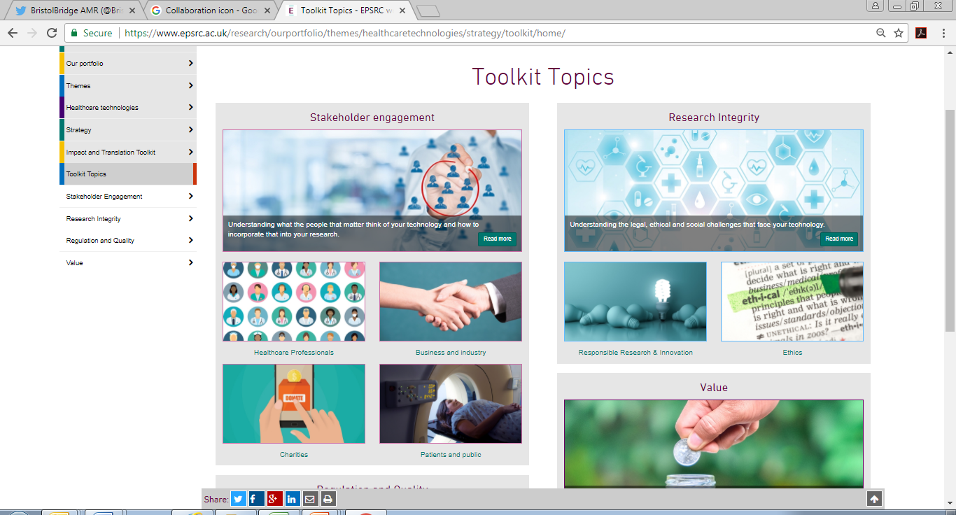
Impact and translation toolkit
https://www.epsrc.ac.uk/research/ourportfolio/themes/healthcaretechnologies/strategy/toolkit/

Slide 31
Implementing our strategy- fellowships
  Many additional opportunities for EPSRC fellowships funding for research relevant to health including:
Theme | Priority area
Digital Economy | Advancing the Understanding and Development of the Internet of Things for the Digital Economy
Engineering | Advanced Materials Engineering
 | Assistive technology, rehabilitation and musculoskeletal biomechanics
 | Control Engineering
 | Microsystems
 | Performance and Inspection of Mechanical Structures and Systems
 | Robotics and Autonomous Systems (joint with ICT)
 | Software development for novel Engineering research
 | Synthetic Biology
ICT | Working Together
Manufacturing the Future | Scale up methodologies for novel manufacturing products and processes
 | Sustainable Feedstocks (e.g. biopharmaceuticals)
Mathematical Sciences | Mathematical Aspects of Operational Research
 | New Connections from Mathematical Sciences
 | Statistics and Applied Probability
Physical Sciences | Analytical Science
 | Chemical Biology and Biological Chemistry
 | Grand Challenges - Understanding the Physics of Life
Across all themes | Complexity Science
Notes:
As part of the implementation of the strategy we will need to make changes to our fellowships priorities.
However, in the last few years, many EPSRC themes have opened up fellowship priority areas relevant to healthcare technologies and some of these are listed here.
Some themes plan changes to coincide with research area strategies publication in Jan 2017- if the above are of interest would be worth thinking about getting an application in in the next 6 months.

Slide 32

Other funding opportunities-
EPSRC HT
Healthcare Technologies Challenge Awards round 3
launch late 2017/early 2018.
Programme Grants
Established career fellowships
Discipline hopping
Targeted therapeutic delivery
Call autumn 17
Healthcare Impact Partnerships??
tbc
Notes:
Focussing on delivering key strategic priorities.
We will use our grand challenges in future discussions with applicants for critical mass investments such as programme and platform grants.
There are fewer calls than the HT community will have been used to, since the start of the theme in 2011. This is due to Council’s aspiration to increase the amount of community driven research in our portfolio. What this means for HT is that we will need to deploy our targeted funding opportunities more selectively, and to factor the strategy for HT more strongly into the assessment and funding of standard mode proposals.
As an organisation, we are looking at how best to deliver strategy through a community led portfolio of research and as part of that the theme will begin batching standard mode proposals after Jan 2017.

Slide 33
Other funding opportunities- working with other funders
CRUK/EPSRC Multidisciplinary Awards
Further two rounds of this initiative per year (open)
UK Prevention Research Partnership
Mental Health
Launched May 17, call for research consortia and Networks+ launched 30 Oct
RCUK Strategy published July,
Call for Networks+
Notes:
Focussing on delivering key strategic priorities.
We will use our grand challenges in future discussions with applicants for critical mass investments such as programme and platform grants.
There are fewer calls than the HT community will have been used to, since the start of the theme in 2011. This is due to Council’s aspiration to increase the amount of community driven research in our portfolio. What this means for HT is that we will need to deploy our targeted funding opportunities more selectively, and to factor the strategy for HT more strongly into the assessment and funding of standard mode proposals.
As an organisation, we are looking at how best to deliver strategy through a community led portfolio of research and as part of that the theme will begin batching standard mode proposals after Jan 2017.

Slide 34
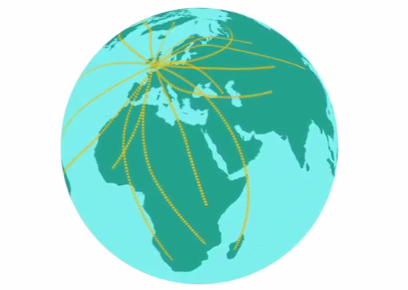
International Centre to Centre Call
New internationally focused funding route for leading UK research groups to work with the best international collaborators in bilateral partnership
December 2017 launch a pilot call.
Outline proposals due in May 2018.
INVESTMENT
1. high-profile, best-with-best international collaborations focused on excellent research with impact;
2. high-quality research collaborations which address Delivery Plan ambitions;
3. UK’s strategic needs in international science and innovation partnerships.
Aims
INTERNATIONAL

Slide 35
Funding International Collaborations
You can apply for the UK side of an international collaboration with any funds going through a UK university including:
  UK employed post docs based for extended periods in overseas laboratories (with EPSRC funds covering travel subsistence & consumable costs incurred while in partners group etc.),
  Cost of access to facilities (if not free at point of access),
  Equipment funded by EPSRC can be based in an overseas lab but would be bought and owned by UK institution,
  Hosting costs for overseas researchers spending time in UK labs
  Costs for PI, Co I and post doc visits to overseas labs.
  Subcontracted service e.g. making specialist samples- could include a contribution to overseas salary cost as part of service provided
  EPSRC fellows can spend up to 12 months of their fellowship overseas
In standard grants the salary costs of an overseas collaborator (as a co- investigator) are not an eligible cost. Some GCRF calls are exceptions- check call for specifics.
Notes:
For GCRF there are exceptions to this.
You can have Co-I from the LMIC and these are charged at 100% costs (no FEC).
Need to register the LMIC institution on JeS- can take up to 6 weeks- so do this asap if you want to list collaborators as co_Is.
Otherwise you can cost time as a contractor at 100% costs also.

Slide 36
10 pearls of HT wisdom…
Research is a people business
The 2 most important pages in your proposal are your response to reviewers
The only person that can fix multidisciplinary peer review is you
Its OK to admit you don’t know. Often, it’s essential.
Sometimes, not getting what you want is a stroke of luck.
We are fighting disease, not fighting each other
Being proactive is a competitive advantage
Don’t take what works for granted
Listen- you may (will) learn something
Collaboration building is a long term investment

Slide 37
Building your networks through EPSRC Networks
Challenge driven research communities
New collaborations with academia, industry and clinicians
workshops, visits and part-time coordinators
Grand Challenges
Pump priming funding

Slide 38
Is collaboration building a good use of time/resource?
11 Bridging the Gap Networks
17 Papers submitted
108 Funded pump priming
84 grant applications submitted
funders: NERC, BBSRC, ESRC, Wellcome, Horizon 2020, MRC, Innovate UK, AHRC, EU SME, EU FTI, EPSRC, British Heart Foundation
189 events
Notes:
Imperial HT portfolio £30.8M, 32 grants.

Slide 39
Facilitating multidisciplinary research in Imperial College- case study
Pump Priming Projects
Sandpit
Dragon’s Den
Tech vs Infectious Disease Summit
Seminar series
Fellows

Slide 40
HT Network Plus
Therapy Ultrasound Network for Drug Delivery and Ablation Research (ThUNDDAR), Institute of Cancer Research, Prof GRt ter Haar: Seeks to stimulate translational research that will enable the potential of therapeutic ultrasound to be fully realised. http://www.thunddar.org/
Closed Loop control systems for optimisation of treatment, University of Nottingham,
Prof SP Morgan: Seeks to provide a treatment that is optimised and personalised to the individual patient via the closed-loop control approach, which involves continuously monitoring key clinical parameters and , informed by mathematical models, adapting treatment.
Fast ASsessment and Treatment in Healthcare (FAST Healthcare), University of Cambridge, Prof AJ Flewitt: Aims to initiate systems-based engineered methodologies for providing joined-up treatment in the public health sector. http://www.fast-healthcare.org.uk/
EPSRC UK Image Guided Therapies Network+, UCL, Prof S Ourselin: Combines simulation and modelling, imaging and sensing, computing, robotics as well as visualisation to improve the localisation and targeting of pathological tissue with surgical instruments and focused energy delivery. http://www.image-guided-therapies.ac.uk/
Grand Challenge Network+ in Proton Therapy, University of Manchester, Prof KJ Kirkby: Aims to create a national infrastructure to meet a national research and training need that will allow the UK community to work together in the multi-disciplinary field of proton research.

Slide 41
HT Network Plus
Osteoarthritis Technology NetworkPlus (OATech+): a multidisciplinary approach to the prevention and treatment of osteoarthritis, Cardiff University, Prof C Holt: The network will address current challenges to trigger the disruptive change in research necessary for future diagnosis and treatment of osteoarthritis.
Healtex: UK Healthcare Text Analytics Research Network, University of Manchester,
Dr G Nenadic: Seeks to build a UK-wide multi-disciplinary research network in order to explore the barriers to effectively utilising healthcare narrative text data, road-map research efforts and principles for sharing text data and text analytics methods between academia, NHS and industry.
GetAMoveOn: transforming health through enabling mobility, UCL, Dr AL Cox: Network focuses on movement as a locus for health. @GAMONetwork

Slide 42
How to get more involved with EPSRC
Peer Review
Predominantly through the college, although we do look outside
Keep your JeS account and web pages up to date and relevant
Review multidisciplinary research as you would wish to be reviewed yourself….
Strategic Advisory Team
Provide Theme Leads with advice on research and training strategy
Annual recruitment process, via an open call
Council aspiration to increase diversity in SAT membership
Read the guidance – there may be call specific criteria that need to be taken into account
Respond quickly and if you say you will do it, do it
New Council for EPSRC in UKRI
Start date of 01 April 2018.
two, three or four year appointments to stagger future appointments
Between five and twelve ordinary members
Senior decision making body responsible for determining policy, priorities and strategy
Build relationship with theme
Build relationship with portfolio managers
@EPSRC, @AnnetteB_HT

Slide 43
EPSRC-NIHR HTC Partnership Award Plus Funds
Technology Network-Plus on Devices for Surgery and Rehabilitation, Imperial, Prof G Yang: Aims to establish a UK technology network for surgical devices and allied technologies including sensors and robotics to support the future of surgical care pathway. http://hamlyn.doc.ic.ac.uk/htc/
NewMind- Partnership with the MindTEch HTC, University of Manchester, Prof CJ Taylor: Seeks to transform the management and treatment of mental health conditions. http://www.newmindnetwork.org.uk/
Medical Devices and Vulnerable Skin: Intelligent sensing to promote self-management, University of Southampton , Prof D L Bader: Aims to reduce the incidence of mechanical-induced damage of vulnerable skin caused by interventional medical devices in various clinical settings. ttp://www.southampton.ac.uk/mdvsn/index.page
IMPRESS, University of Leeds, Dr P R Culmer: Aims to understand the current challenges faced in the management of incontinence and to bring about a transformation in sentiment towards incontinence technologies. http://www.impress-network.com/page/impress
Medical Image Analysis Network (MedIAN), University of Oxford, Prof A Noble: Seeks to identify new opportunities for medical image analysis methodology research and early clinical translation within high morbidity/unmet needs of NIHR cardiovascular HTC and HTCV in Colorectal Therapies. http://www.ibme.ox.ac.uk/MedIAN
UNIFY Plus, Loughborough University, Prof DJ Williams Focussed on addressing major unmet clinical need in the repair and rehabilitation of non-union fractures.

Slide 44
A reminder….
    Remit query: Use the form here and we will work across RCs to find the best home for your research.
    Cross Council Funding agreement:
      applies in responsive mode only
      In principle applies to all grants but contribution of non-lead Council is capped (unless other arrangements have been made before the proposal is submitted)

Slide 45
Thanks for listening
Further questions and enquiries can be sent to:
healthcare@epsrc.ac.uk
Or contact a member of the Healthcare team see here

