Slide 1
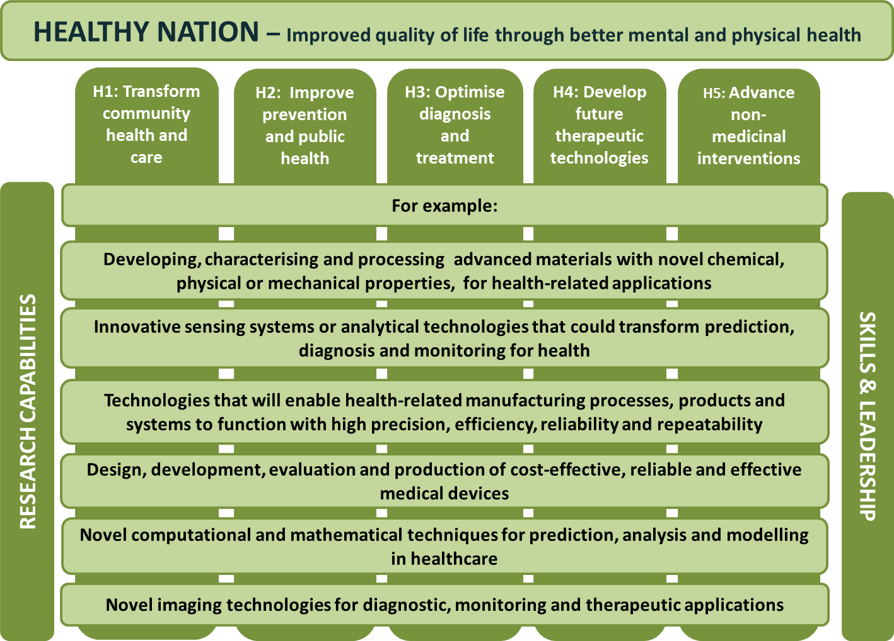
Healthy nation
Communicating the EPSRC Delivery Plan

