Slide 1


The educational progress of looked after children: linking care and educational data
University of Exeter 13 June 2017
Judy Sebba
Director Rees Centre for Research in Fostering and Education
University of Oxford Department of Education
judy.sebba@education.ox.ac.uk

Slide 2
Rees Centre for Research in Fostering and Education
The Rees Centre aims to:
identify what works to improve the outcomes and life chances of children and young people in foster care
We are doing this by:
reviewing existing research in order to make better use of current evidence
conducting new research to address gaps
working with service users to identify research priorities and translate research messages into practice
employing foster carers and care experienced young people as co-researchers
Centre is funded by the Core Assets Group but also has grants from a range of other funders

Slide 3
Some outcomes of children in care in England
14% achieve expected grades (5 x A*- C incl Eng & maths) at 16 years compared to 53% of all children – a gap of 39% (calculation changed in 2014*);
achievement gap is lower at KS2 (28% gap in all 3 subjects, 23% for maths, 18% reading, 26% writing);
Two times as likely to be permanently excluded;
More than five times more likely to have fixed term exclusion (10% of LAC have at least one);
Of 27,220 former care leavers aged 19-21, 38% were not in education, employment or training - NEET;
Only 8% access HE compared to > 50% of general population;
educational experiences and outcomes contribute to later health, employment (22% unemployment rate), involvement in crime (27% of those in prison).
DfE (2016)Outcomes for LAC 31 March 2015, *restricted qualif, 1st entry only

Slide 5
Main findings from the review
28 studies reporting outcomes from UK, Australia, USA and Canada
Children in care lag behind their peers on educational attainment (grades, literacy and numeracy test scores);
Children in care have lower school attendance and a higher risk of exclusion;
There is a strong link between being in foster or kinship care and educational outcomes;
When factors such as gender, ethnicity and special educational needs are accounted for, the link between being in care and how well children do in education is not as strong;
When children in care are compared to similarly disadvantaged children who are not in care, the attainment gap is reduced.

Slide 6

Research design
Rees Centre/University of Bristol study, funded by The Nuffield Foundation
Linked national data sets on the education (National Pupil Database) and care experiences of looked after children in English schools Year 11
Interviewed 26 young people (high- and lower- progress) in six local authorities and with their carers, teachers, social workers and Virtual School staff
http://reescentre.education.ox.ac.uk/research/educational-progress-of-looked-after-children/
Notes:
David Berridge will talk about the findings from the interviews

Slide 7
Research design
Linked NPD and CLA databases for 2013 KS4 Cohort
Retrospective study
8 best outcomes (GCSE + equivalents)
  A* = 58 points; maximum 464 points
  6 points = 1 grade on 1 exam
Groups for analysis:
  CLA-LT: A longer-stay group of Children Looked After (those in care for 12 months or more continuously at the end of KS4)
  CLA-ST: A shorter-stay group of Children Looked After (those in care for less than 12 months at the end of KS4)
  CIN: Children in Need at the end of KS4 but not in care
  Comparison group: Children not in care and not in need at the end of KS4

Slide 8
Database analyses
Descriptive statistics – how do CLA compare to peers on factors generally linked to educational outcomes?
Regressions – which factors predict better or worse educational outcomes for CLA?
Multilevel modelling – what is the relative contribution of factors at different levels?
Local authority
School
Individual child
Notes:
Not reporting on MLM today

Slide 9
Description of our cohort
7,852 looked after children eligible for GCSEs in 2013
4,847 had been in care for 12 months or more continuously, of whom:
  over half first entered care as teenagers
  29.0% had been in most recent placement for under a year
  59.6% were in foster care (vs. 70.2% at age 11)
  18.5% were in residential care (vs. 11.3% at age 11)
  17.3% had only had one placement
  10.2% had had 10 or more placements since first entering care
Notes:
Only children who were in care in final year of compulsory schooling – so not representative of overall care population

Slide 10
Comparing CLA and peers
 | N | Mean KS4 points | Controlling for KS2
Comparison Group (Not on the 2012-13 CIN or CLA databases) | 622,970 | 340.59 | 341.66
CIN (Children in the CIN database but not CLA) | 13,599 | 185.14 | 249.77
CLA-ST (Looked after at 31 March 2013 but not 12 months continuously) | 1,387 | 149.52 | 200.38
CLA-LT (Looked after at 31 March 2013 and for 12 months or more continuously) | 4847 | 202.41 | 267.46

Slide 11
Predicting Educational Outcomes
EARLY ENVIRONMENT
CARE PLACEMENTS
FSM at KS1
Home language at KS1
Placement changes since KS2
Length of time in care
Home language at KS4
Placed out of authority at KS4
IDACI at KS1
Care career type
Length of latest placement
FSM at KS4
In non-foster placement at KS4
IDACI at KS4
INDIVIDUAL
RELATED TO SCHOOLING
Gender
Mean SDQ score
KS2 scores
School changes in Year 10-11
In non-mainstream school at KS4
Ethnicity
Primary SEN
Unauthorised absences
Fixed & permanent exclusions
Notes:
These are all the variables we included in the regression model for looked after children – next slide shows the significant predictors.

Slide 12
Significant predictors (unstandardised betas)
EARLY ENVIRONMENT
CARE PLACEMENTS
Each change since KS2
-2.3 pts
Home language at KS4 not English
-18.8 pts
Disability
-18.2 pts
Each extra month in latest placement
+0.09 pts
Foster or kin placement KS4
+37.3 pts
INDIVIDUAL
RELATED TO SCHOOLING
Male
-7.6 pts
1 pt higher on SDQ
-1.7 pts
Each extra point in KS2 scores
(range 2.5-8.0)
+39.6 pts
Change in Year 10 or 11
-33.9 pts
Special -87.6 pts
PRU -88.2 pts
AP -121.4 pts
ASD -38.2 pts
MLD -10.4 pts
SMLD -87.6 pts
10% absence (unauthorised)
-25.5 pts
Each day excluded
-1.08 pts
Notes:
Other non-mainstream: -60.3 pts

Slide 13
Findings from quantitative analyses 1
Controlling for pupil- and school-related factors, those in care make better educational progress than those ‘in need’
  Care system appears to act as a protective factor educationally
Late adolescent entrants into care make poorer educational progress
  May reflect reasons for entry into care and greater instability
Both school and care factors are related to educational outcomes
Instability (school or care) is a very important factor particularly in last two years of schooling.

Slide 14
Findings from quantitative analyses 2
Emotional and behavioural issues as reflected by the SDQ scores may underlie difficulties
  BUT response of school and care systems to young people’s characteristics and circumstances are at least as important
Overall, little variation between local authorities nationally on progress of children in care once other factors are controlled
  Key factors are at the level of the individual and school
Schools that perform better with all students also show good progress for out-of-home care students

Slide 15
What does this mean for young people?
Students in care did better than those who were ‘in need’ but not in care, and better than those who had been in care for under 12 months, so care appears to protect them.
Young people in foster or kinship care at age 16 scored higher than those in residential or other placement types.
Young people who changed school during final two years scored over five grades less than those who didn’t.
For every 5% of school sessions missed - unauthorised absences, young people scored two grades less.
For every additional day of school missed due to fixed-term exclusions, young people scored one-sixth of a grade less.

Slide 16
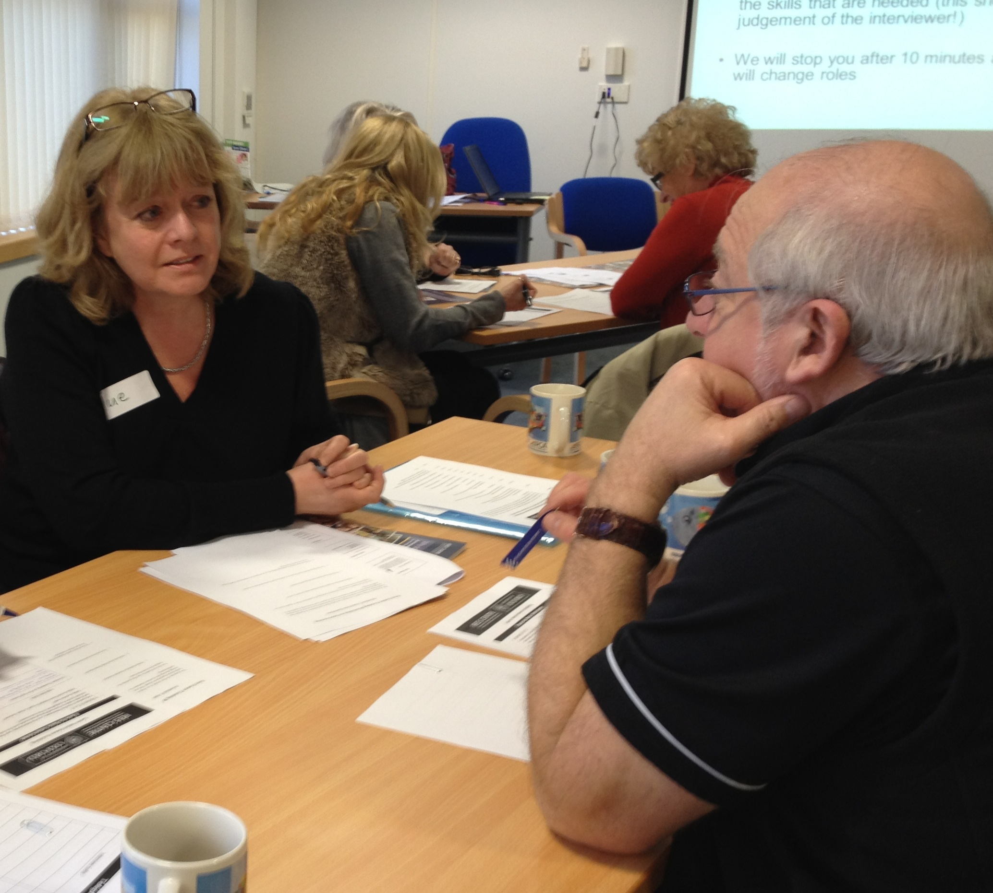
Interviews with young people in Out-of-Home Care and those supporting their education
Worked in six local authorities
  26 young people (‘high-’ and ‘lower-progress’ groups)
Interviews with young people, carers, teachers and social workers

Slide 17
Findings from qualitative interviews
Continuing birth family influence for nearly all
Young people’s agency
  Choose to engage with education once certain preconditions met
Overwhelming view that coming into care had positive effects educationally and overall
Foster carers’ level of educational support seemed more important than their educational qualifications per se
Teachers most important educational influence.
Young people welcomed the additional, individual support – Flynn’s work on one-to-one tuition.

Slide 18
Continuing birth family influence
I remember the night before my English GCSE exam, she phoned me up, like, with suicide voicemails and everything, so it just made me lose a lot of focus, so I stopped having contact with her...like, I couldn’t go upstairs and revise English or anything, or do an essay, because I’d get worried that she would be...my mind would be on her and what she would be doing, like if she was going to threaten the people that I lived with, or me, or anything like that. So it made me lose a lot of focus and stuff, and got me quite anxious…so I couldn’t focus on anything else that I wanted to focus on. My mind was set somewhere else, so I wouldn’t have been able to focus very well.
Notes:
This young woman wanted to know why the social worker wasn’t looking after her mum rather than bothering her.
This burden of responsibility for vulnerable parents was often referred to by young people. It isolated them further from their peer group.

Slide 19
^{Identity in school}
Like I said, no one barely, at school knows I’m in care, so they would never, ever, ever... I think, if they knew, it would be harder for me to just act like I weren’t. Like, it would be harder for me to focus on my education and stuff, because I’d constantly be thinking, ‘Oh...’ Like, you’d conform, I think. I think if people knew, like, what you were like as being a foster kid, and what everyone else is like as a foster kid, you’d conform, not even realising you were. But, I think where no one really knows, I actually see myself as not in care. Do you know what I mean? I actually see myself as normal, as the rest of my friends are, with parents, and stuff like that.
Notes:
Demonstrates the importance of Young People’s agency as reflected in the programme of this conference

Slide 20
Implications
Greater focus on progress needed
Are young people ‘in need’ a more helpful comparison for those in care than the whole school population (but need to remain aspirational) – see DfE Statistical First Release March 2016
When placement moves are essential, school moves should be avoided especially in the final years of schooling
School choice not a matter of ‘academic’ OR ‘nurturing’
Importance of involving young person in decisions
Teacher development in social, emotional and mental health issues; social worker development in education system
Schools reaching out to foster carers

Slide 21
‘London Fostering Achievement’ - programme to raise standards of children in care across London
Four components:
Generic Foster Carer Training: Nov 2014 - March 2015 a one-day session - 1265 foster carers, social workers, teachers, etc. attended working across London.
Masterclasses: Over 400 people attended one of four half-day training exploring one area e.g. attachment, in more depth.
Direct work with schools: Children in care in 25 schools were targeted for raising achievement. Schools supported by coach for one year.
Education Champions: Ten experienced foster carers employed part-time to work with foster carers on supporting educational needs.

Slide 22
Outcomes of London Fostering Achievement Programme
Generic training well received - mix of people (e.g. foster carers, teachers, social workers) enabled them to better understand each other’s roles.
Some carers challenged the schools’ allocation of ‘Pupil Premium Plus’ as a direct impact of the Programme.
The impact of the direct work with schools was limited. Attainment of 45 pupils showed no greater progress than those in other schools.
The Education Champions had most impact providing foster carers with information, direct support and increased confidence.
Notes:
Some of the PEPs, PPP translated into practice

Slide 23
There must be a better way….
…being in care and having problems got in the way [of my education] because every single time I moved a placement it was during a school day… slap bang like 12:00 for example I will be in English, I am getting called out of the lesson, my social worker will suddenly be outside, I will be like ‘What is going on?’ She is like ‘Oh you can’t stay in your placement anymore’…Everyone else is in their English class like ‘Oh what is going on with [name]…I am there telling them to F off, you know, just trying to focus? Hearing bad news, trying not to cry, because there is like a window through the door and they will see me crying… Every single time I move to a placement it just disrupted my school life.
(YP, aged 17, GLA London Fostering Achievement Evaluation)

Slide 24
Impact of the research
Government statistics now compares educational outcomes of children in care to children ‘in need’ and the general population.
ADCS/NAVSH – new monitoring system
‘Virtual School Heads’ (responsible for education of out-of-home children):
stopping children moving school in last two years;
ensuring placed in higher performing, mainstream schools where possible;
providing better support to those in residential care;
Extending ‘attachment awareness’ training for schools.
Education Champions being introduced in other areas.
‘Ofsted’ inspection teams crossing care/education and greater focus on progress.

Slide 25
What can schools and do to improve outcomes?
School can provide stability, a safe place in a turbulent world, an opportunity to excel, and a route out of their difficulties into a more positive future;
http:www.youtube.comwatchv=DNlZt_6zsEU&feature=youtu.be
School success can affect placement stability & vice versa (Sinclair et al, 2005). Do schools reach out to foster carers/residential workers? 40% of foster carers do not attend parents’ evenings;
Positive aspects of ordinary care predisposes LAC to benefit from interventions targeted at improving mental health;
High quality teaching benefits most pupils, those receiving PP(P) especially so. Every teacher has a responsibility
http://educationendowmentfoundation.org.uk/toolkit/

Slide 26
Further Research 1
Nuffield Foundation Sept 2017 – April 2019
LAC and Children in Need (CIN; those receiving social work support while living at home)
Prospective rather than retrospective - all children in England who were KS1 in 2006-2007, track their care and educational
periods as CIN or CIC at any stage of their schooling histories through to GCSEs in 2016-2017 (KS4) i.e. educational trajectories of YP in distinct groups - those whose early difficulties are successfully resolved, those who remain ‘edge of care’, and those who go in and out of care
Interviews will be conducted with 30 LAC and 30 CIN and their parents/carers, social workers and teachers, and VSHs

Slide 27
Further Research 2: Letterbox/Paired Reading RCT
ESRC Jan 2018 – June 2020
Main RQ: effectiveness of the two modes of delivery in improving reading outcomes and attitudes towards reading among fostered children aged 7-9 years old in England and NI
Letterbox - run by Booktrust, 6 personalised packs of books posted to the children once a month from May to October. Pre/post reading scores positive, but RCT found no differences
Paired reading – foster carer trained to undertake > 3 x 20 min sessions/wk effective in accelerating learning but pre/post.
  Group 1 - Letterbox and reading manual
  Group 2 - Letterbox, manual and training in paired reading
  Group 3 – Control, nothing in Yr 1 but Letterbox afterwards
500 children in foster care across England and NI
Measures of reading rate & accuracy and attitudes, interviews with 30 children, their foster carers and social workers.

Slide 28
How you can be involved
Express interest in being involved in future possible research projects;
Come along to lectures & seminars and log into webinars;
Join our mailing list and receive newsletters 5 times/year rees.centre@education.ox.ac.uk;
Web - http://reescentre.education.ox.ac.uk/;
Comment on our blog – or write for us;
Follow us on Twitter - @ReesCentre

Slide 29
References
Mooney, J., Winter, K. and Connolly, P. (2016) Effects of a book gifting programme on literacy outcomes for foster children: A randomised controlled trial evaluation of the Letterbox Club in Northern Ireland. Children and Youth Services Review, 65, pp.1-8.
O’Higgins, A., Sebba, J. & Luke, N. (2015) What is the relationship between being in care and the educational outcomes of children? An international systematic review. Oxford: Rees Centre
Osborne, C., Alfano, J. and Winn, T (2010) Paired reading as a literacy intervention for foster children. Adoption and Fostering, 34, 4, 17-26
Sebba, J. & Dingwall, N. (2017) Evaluation of the Attachment Aware Schools' Programme in Bath and NE Somerset. Oxford: The Rees Centre
Sebba, J., Luke, N., Rees, A., Plumridge, G., Rodgers, L., Hafesji, K. and Clare Rowsome-Smith (2016) Evaluation of the London Fostering Achievement Programme. Oxford: The Rees Centre.
Sebba, J., Berridge, D., Luke, N., Fletcher, J., Bell, K., Strand, S., Thomas, S., Sinclair, I., O’Higgins, A., (2015) The Educational Progress of Looked After Children in England, The Rees Centre and the University of Bristol.
Sinclair, I., Wilson, K. & Gibbs, I. (2005) Foster Placements: Why they succeed and why they fail. London: Jessica Kingsley Publications

